Slide 1
Introduction to the Operating Systems
Dr. Ugur CORUH

Slide 2
Operating System List
DOS
Linux
MAC OS X
Windows
Unix
Amiga
Pardus
Plan 9
Chromium

Slide 3
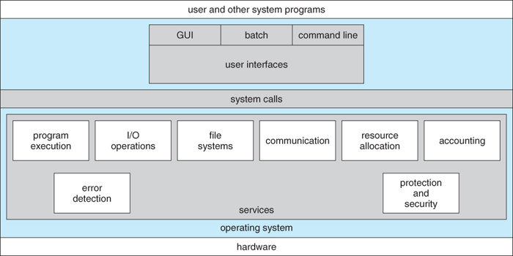
Operating System Architecture
https://www.cs.uic.edu/~jbell/CourseNotes/OperatingSystems/2_Structures.html

Slide 4

Operating Systems
https://www.educba.com/linux-vs-mac-vs-windows/

Slide 5
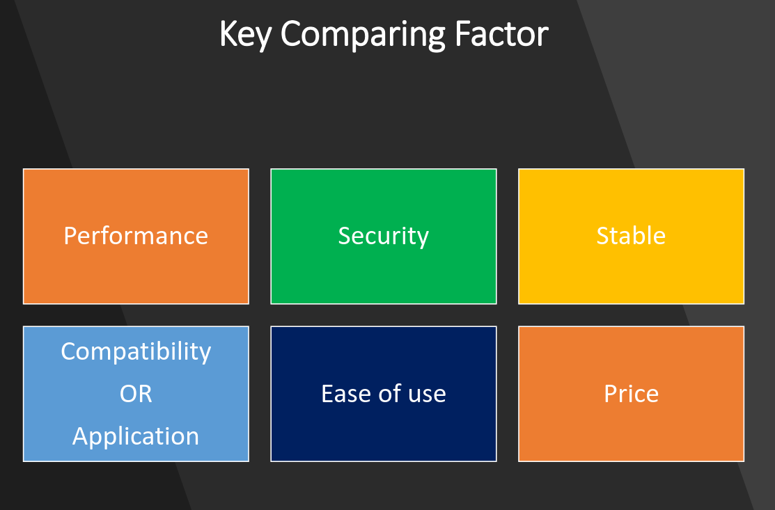
Operating Systems
https://www.slideshare.net/quanhan503/comparing-windows-vs-mac-vs-linux

Slide 6
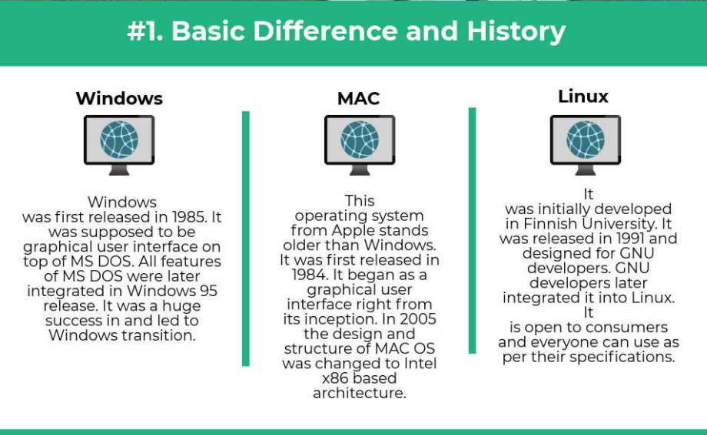
Operating Systems
https://www.educba.com/linux-vs-mac-vs-windows/

Slide 7
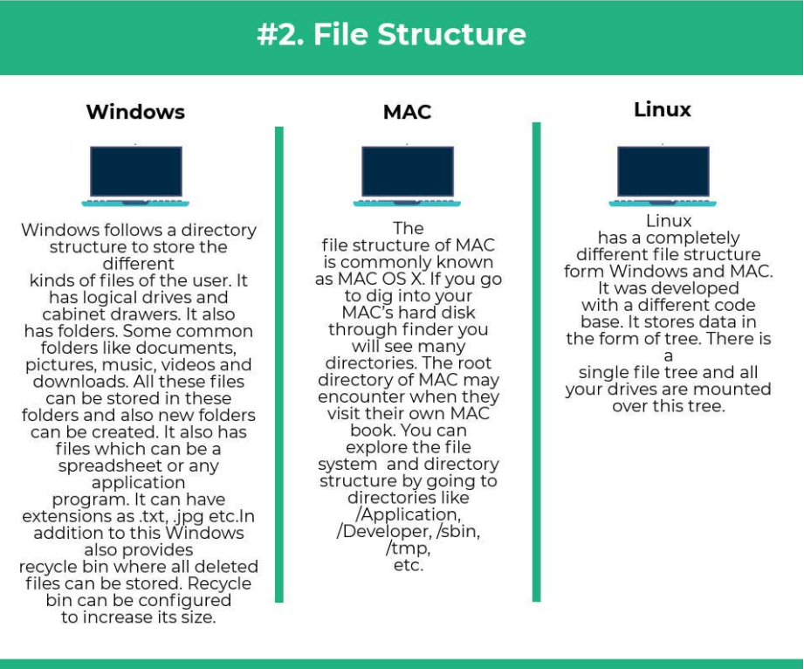
Operating Systems
https://www.educba.com/linux-vs-mac-vs-windows/

Slide 8
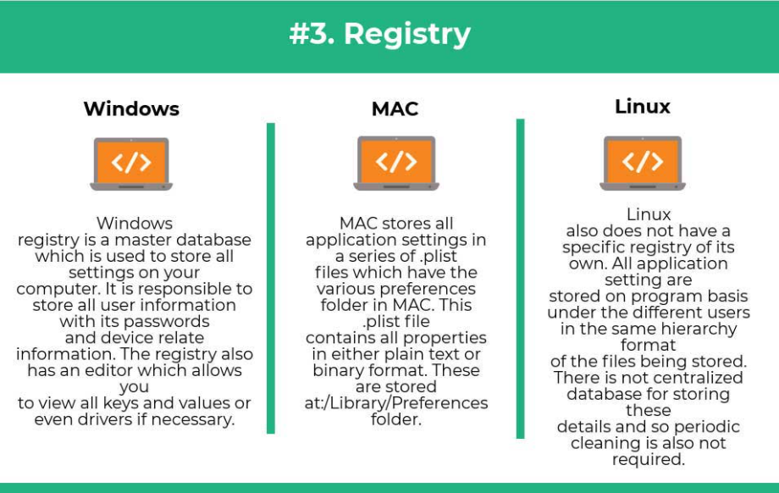
Operating Systems
https://www.educba.com/linux-vs-mac-vs-windows/

Slide 9
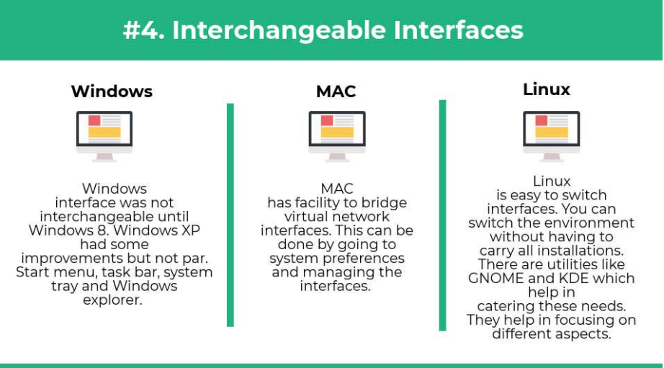
Operating Systems
https://www.educba.com/linux-vs-mac-vs-windows/

Slide 10
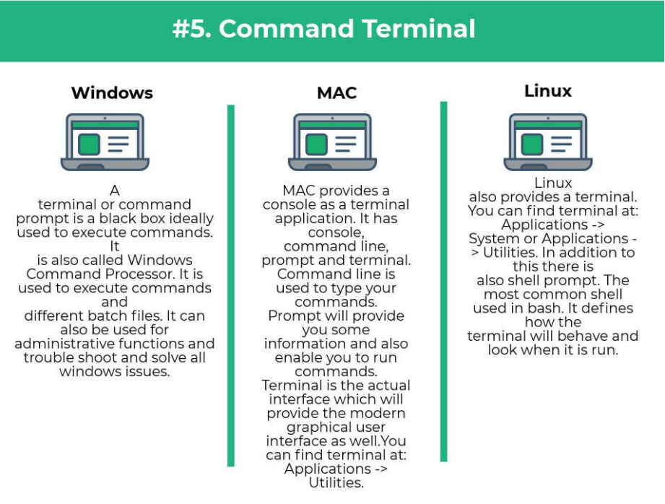
Operating Systems
https://www.educba.com/linux-vs-mac-vs-windows/

Slide 11
Introduction to the Internet
Dr. Ugur CORUH

Slide 12
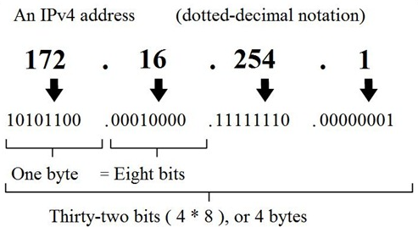
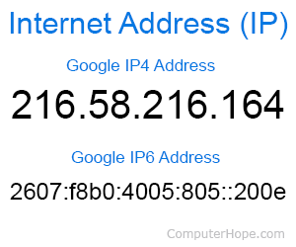
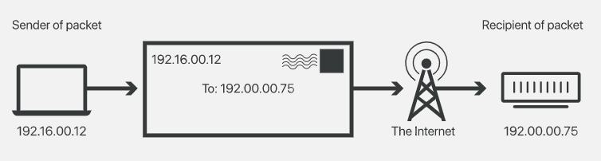
What is IP Adress?

Slide 13
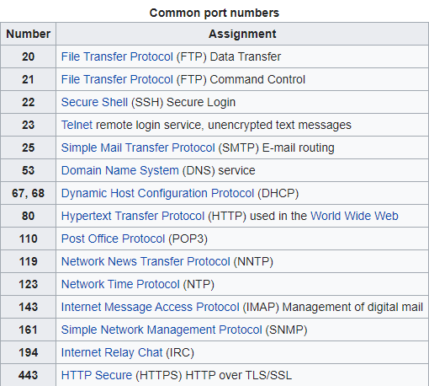
What is Port?
In computer networking, a port is a communication endpoint. At the software level, within an operating system, a port is a logical construct that identifies a specific process or a type of network service. A port is identified for each transport protocol and address combination by a 16-bit unsigned number, known as the port number. The most common transport protocols that use port numbers are the Transmission Control Protocol (TCP) and the User Datagram Protocol (UDP).
https://en.wikipedia.org/wiki/Port_(computer_networking)

Slide 14
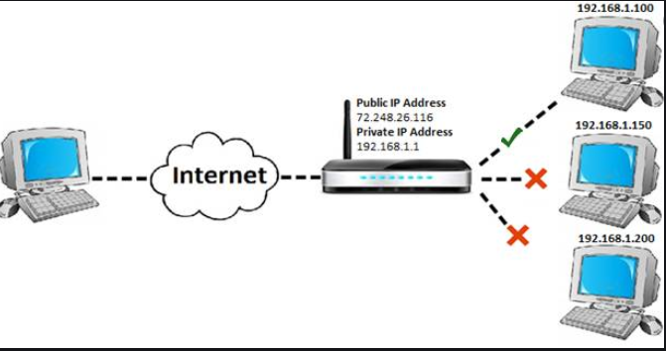
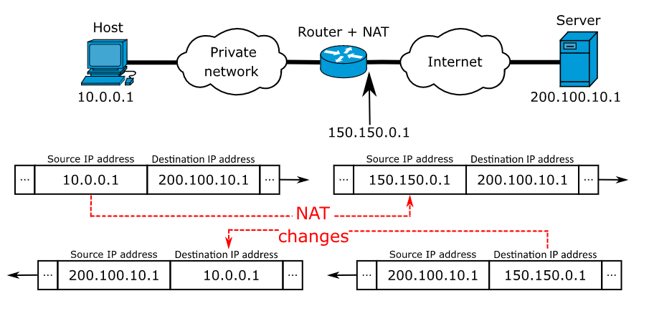
What is Port Forwarding and NAT?
https://en.wikipedia.org/wiki/Network_address_translation
https://www.networkantics.com/sonicwall-port-forwarding/

Slide 15
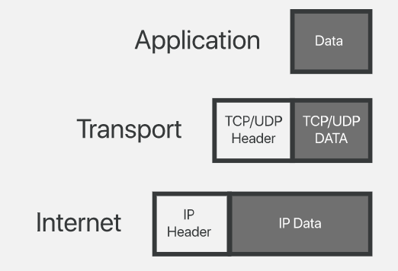
What is Internet Packet?

Slide 16
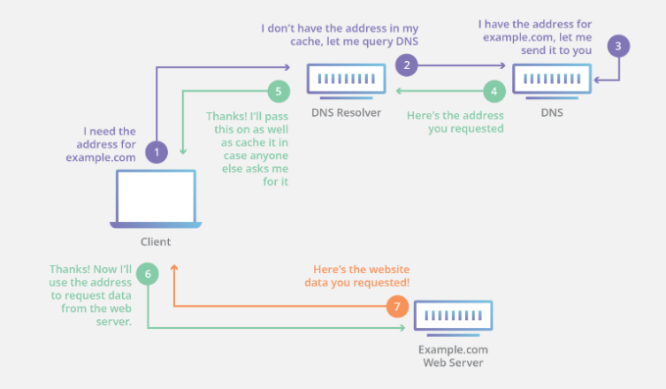
What is Domain Name Server (DNS)?

Slide 17
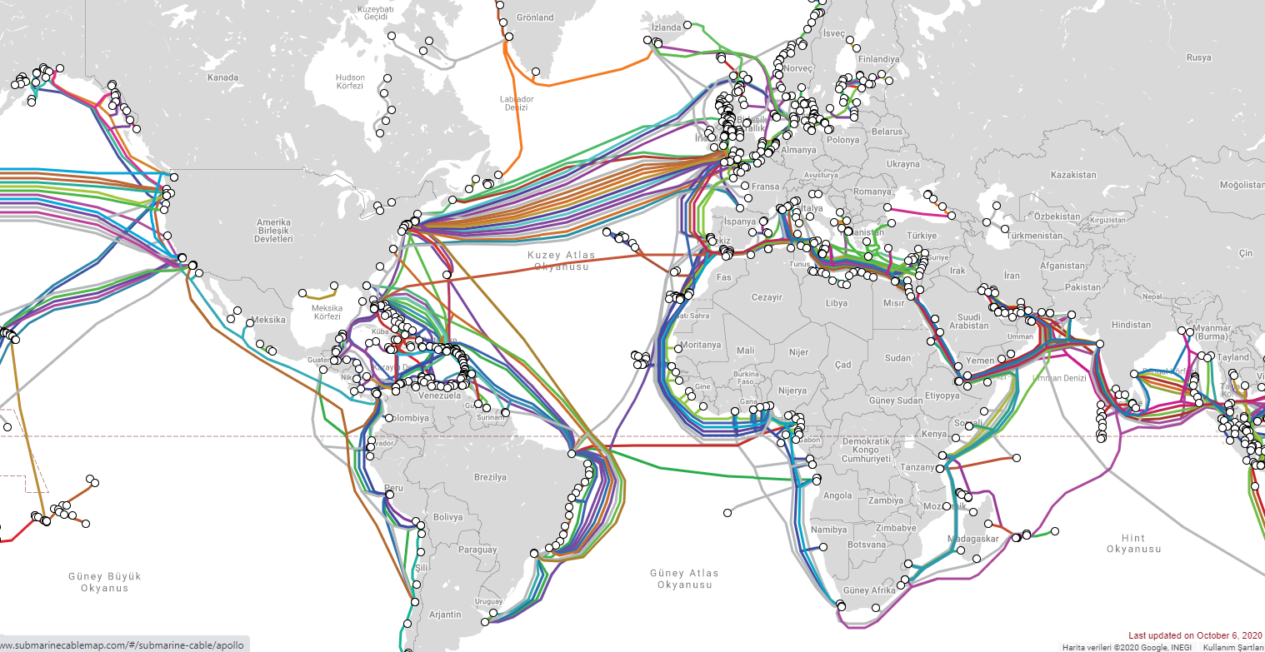
The Submarine Cable Map
https://www.submarinecablemap.com/

Slide 18
Introduction to the Algorithmic Thinking and Pseudocodes
Dr. Ugur CORUH

Slide 19
Introduction to the Algorithmic Thinking and Pseudocodes
Dr. Ugur CORUH

Slide 20
Introduction to the Software Development
Dr. Ugur CORUH

Slide 22
Introduction to the Programming Languages
Dr. Ugur CORUH

Slide 23
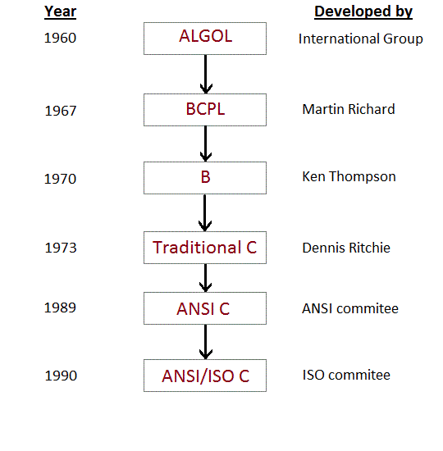
C Programming: History of C
https://www.programming-techniques.com/2011/08/c-programming-history-of-c.html

Slide 24
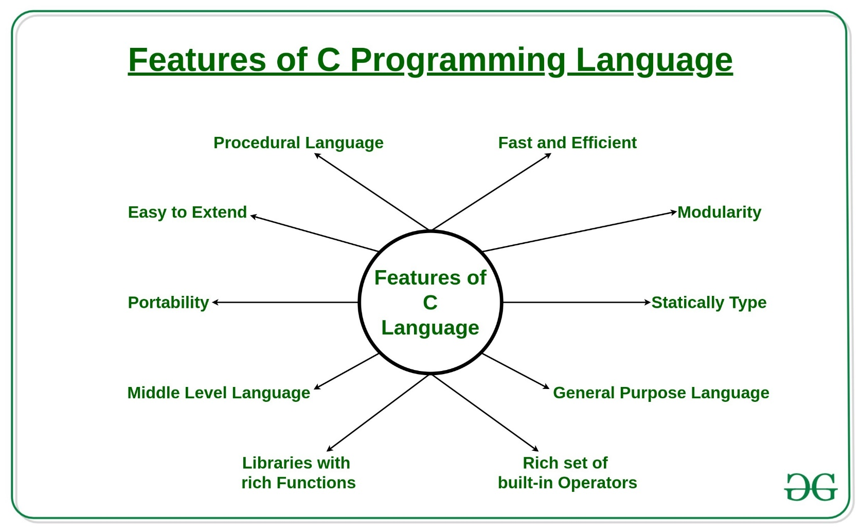
C Programming: History of C
https://www.geeksforgeeks.org/features-of-c-programming-language/

Slide 25
C Programming: History of C
Procedural Language:
In a procedural language like C step by step predefined instructions are carried out. C program may contain more than one function to perform a particular task. New people to programming will think that this is the only way of a particular programming language works. There are other programming paradigms as well in the programming world. Most of the commonly used paradigm is an object-oriented programming language.
Fast and Efficient:
Newer languages like java, python offer more features than c programming language but due to additional processing in these languages, their performance rate gets down effectively. C programming language as the been middle-level language provides programmers access to direct manipulation with the computer hardware but higher-level languages do not allow this. That’s one of the reasons C language is considered as the first choice to start learning programming languages. It’s fast because statically typed languages are faster than dynamically typed languages.
Modularity:
The concept of storing of C programming language code in the form of libraries for further future uses is known as modularity. This programming language van does a very little on its own most of its power is held by its libraries. C language has it’s own library to solve common problems like in this we can use a particular function by using a header file stored in its library.
Statically Type:
C programming language is a statically typed language. Meaning the type of variable is checked at the time of compilation but not at run time. Means each time a programmer type a program they have to mention the type of variables used.
General Purpose Language:
From system programming to photo editing software, C programming language is used in various applications. Some of the common applications where it’s used are as follows:
Operating systems: Windows, Linux, iOS, Android, OXS
Databases: PostgreSQL, Oracle, MySQL, MS SQL Server etc.
Rich set of built-in Operators:
It is a diversified language with a rich set of built-in operators which are used in writing complex or simplified C programs.
Libraries with rich Functions:
Robust libraries and functions in C help even a beginner coder to code with ease.
Middle-Level Language:
As it is a middle-level language so it has the combined form of both capabilities of assembly language and features of the high level language.
Portability:
C language is lavishly portable as programs which are written in C language can run and compile on any system with either none or small changes.
Easy to Extend:
Programs written in C language can be extended means when a program is already written in it then some more features and operations can be added into it.
https://www.geeksforgeeks.org/features-of-c-programming-language/

Slide 26
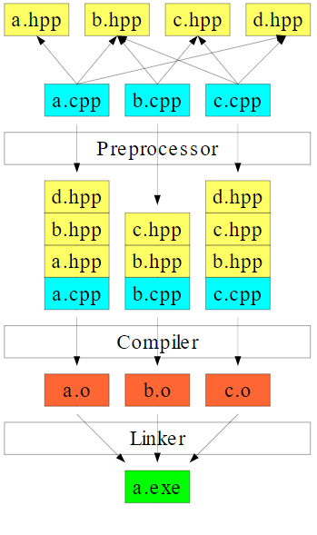
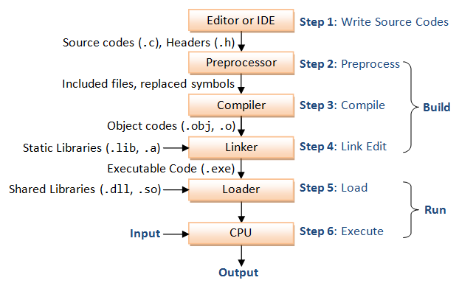
C Programming Flow
https://www.geeksforgeeks.org/features-of-c-programming-language/
https://commons.wikimedia.org/wiki/File:C%2B%2B_compilation_process.svg

Slide 27
Introduction to the command line interface
Dr. Ugur CORUH

Slide 28
What is the command line?
The window, which is usually called the command line or command-line interface, is a text-based application for viewing, handling, and manipulating files on your computer. It's much like Windows Explorer or Finder on the Mac, but without the graphical interface. Other names for the command line are: cmd, CLI, prompt, console or terminal¹
While there are many commands you can use with CLI, they all fall into two categories:
The commands that handle the processes
The commands that handle the files
Ref¹ : https://tutorial.djangogirls.org/en/intro_to_command_line/

Slide 29
Why Would You Use CLI over GUI?
Less Resource
It is not a secret that the text-based program needs very little resources of your computer. This means that with CLI you can do similar tasks with minimum resources.
High Precision
You can use a specific command to target specific destinations with ease. As long as you don’t type the wrong command, it will work like a charm. Once you learn the basics, writing syntax is not as hard as you might think.
Repetitive Tasks Friendly
GUI has developed well over the years. But, the operating system may not give you all the menus and buttons to perform all tasks. One of the reasons is safety. This leaves you overwhelmed if you have to do repetitive tasks. For example, when you have to handle hundreds of files within a folder, CLI enables you to use a single command to do automate the repetition easily.
Powerful
Most operating systems today prevent you from messing up the system’s core process. Windows has system protection and MacOS has SIP (System Integrity Protection). You won’t be able to perform certain tasks which are system protected. However, with CLI, you will have full control over your system.

Slide 30
Open the command-line interface (Windows)
Go to the Start menu or screen, and enter "Command Prompt" in the search field.
Go to Start menu → Windows System → Command Prompt.
Go to Start menu → All Programs → Accessories → Command Prompt.
Go to the Start screen, hover your mouse in the lower-left corner of the screen, and click the down arrow that appears (on a touch screen, instead flick up from the bottom of the screen). The Apps page should open. Click on Command Prompt in the Windows System section.
Hold the special Windows key on your keyboard and press the "X" key. Choose "Command Prompt" from the pop-up menu.
Hold the Windows key and press the "R" key to get a "Run" window. Type "cmd" in the box, and click the OK key.
Ref¹ : https://tutorial.djangogirls.org/en/intro_to_command_line/

Slide 31
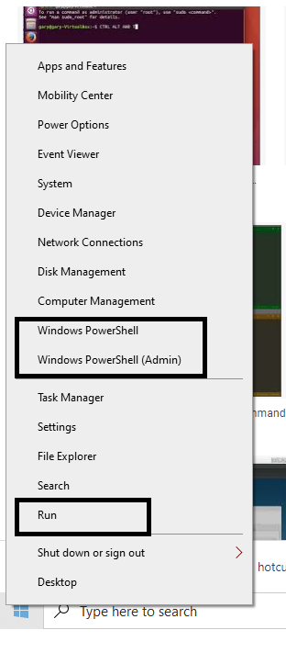
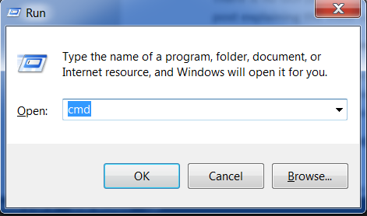
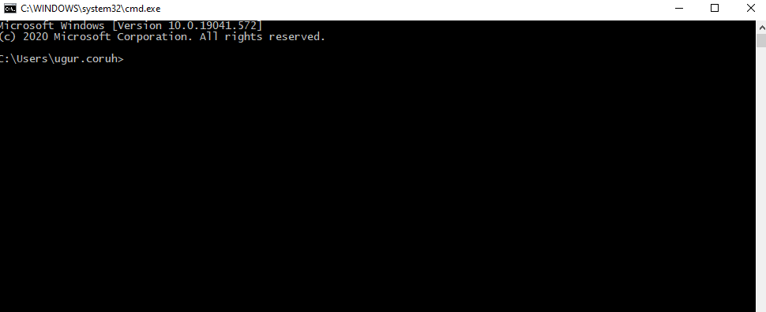
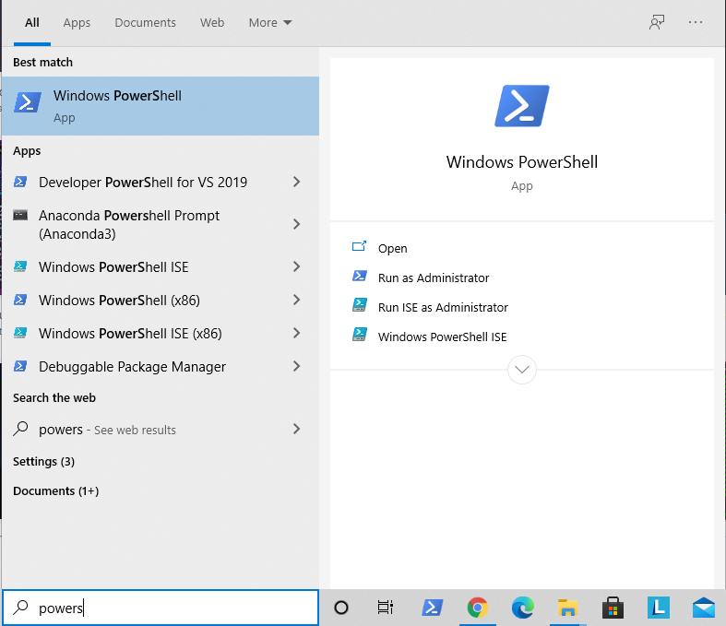
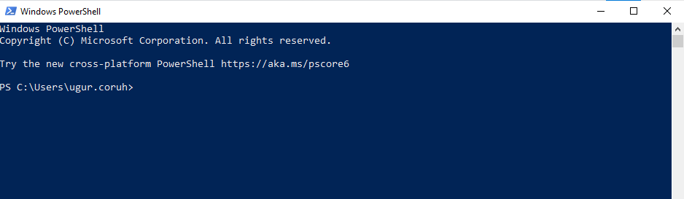
Open the command-line interface (Windows)

Slide 32
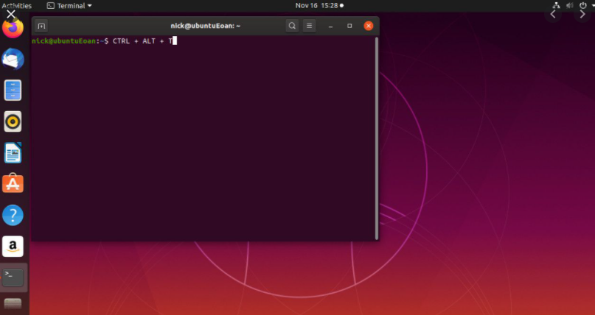
Open the command-line interface (Linux)
It's probably under
Applications → Accessories → Terminal,
or
Applications → System → Terminal,
but that may depend on your system.
If it's not there, you can try to Google it. :)
Ref¹ : https://tutorial.djangogirls.org/en/intro_to_command_line/

Slide 33
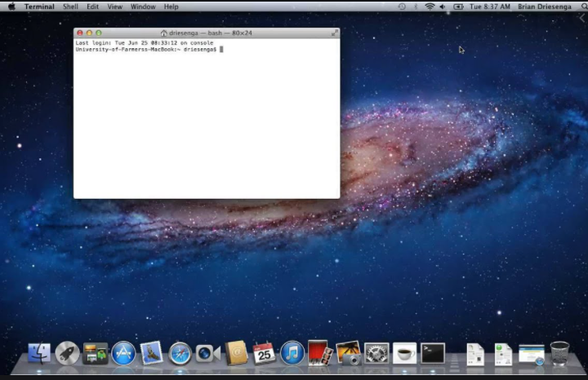
Open the command-line interface (MacOS)
Go to Applications → Utilities → Terminal

Slide 34
Command Basics (Computer Name, Current Directory Path)
> whoami (hit enter)
Result: laptop-rqnns9ig\ugur.coruh
Computer will print username
> pwd
Result: /Users/ugur.coruh
Current Working Directory for Linux and OS X
> cd
Result: C:\Users\ugur.coruh
Current Working Directory for Windows

Slide 35
Learn Command Details
Linux and OS X
> man <command_name>
> man pwd
OS X and Linux have a man command, which gives you help on commands
Use the space bar to move to the next page, and q to quit looking at the help
Windows
Adding a /? suffix to most commands will print the help page
Try cd /?

Slide 36
Command Basics (List files and directories)
Linux and OS X
> ls
Applications
Desktop
Downloads
Music
...
ls -R will list all the files in the sub-directories as well
ls -a will show the hidden files
ls -al will list the files and directories with detailed information like the permissions, size, owner, etc.
Windows
>dir
Volume in drive C is Windows
Volume Serial Number is 8C3C-8F8C
Directory of C:\Users\ugur.coruh
10/14/2020 09:57 AM <DIR> .
10/14/2020 09:57 AM <DIR> ..
08/15/2020 11:00 PM <DIR> .android
06/28/2020 03:02 AM <DIR> .AndroidStudio4.0

Slide 37
Command Basics (List files and directories)
Linux , OS X (you should install with «brew install tree»), Windows
> tree
C:\Users\ugur.coruh\Desktop\Samples>tree
Folder PATH listing for volume Windows
Volume serial number is 8C3C-8F8C
C:.
├───C
│ └───HelloWorld
│ └───.vscode
├───Cpp
├───Csharp
└───Java

Slide 38
Command Basics (Change Current Directory)
> cd <path>
cd Desktop
(print case-sensitive prefix of targer folder and use «tab» to complete or find correct folder )
> cd ..
This command moves current working directory to parent directory.
You can use cd ..\..\.. to go 3 level up.
Also you can change relative path such as cd ..\..\target\child ; go 2 level up and then go to target and child folders.
To directly go to folder write full path of file cd C:\temp\build\target\child
>cd- (with a hyphen) to move to your previous directory
We will use this feature with CMAKE!

Slide 39
Command Basics (Change Current Directory)
> cd <path>
cd Desktop
(print case-sensitive prefix of targer folder and use «tab» to complete or find correct folder )
> cd ..
This command moves current working directory to parent directory.
You can use cd ..\..\.. to go 3 level up.
Also you can change relative path such as cd ..\..\target\child ; go 2 level up and then go to target and child folders.
To directly go to folder write full path of file cd C:\temp\build\target\child
We will use this feature with CMAKE!

Slide 40
Command Basics (Create Directory)
Windows, Linux, OS X
> mkdir folder_name
To generate a new directory inside another directory, use this Linux basic command mkdir Music/Newfile
use the p (parents) option to create a directory in between two existing directories. For example, mkdir -p Music/2020/Newfile will create the new “2020” file.
Check folder creation is succeed with list commands (Linux,OS X -> ls) (Windows -> dir or tree)
> dir
Use cd folder_name from current directory for going to created folder.
> cd folder_name

Slide 41
Command Basics (Remove Directory)
Windows Powershell, OS X and Linux
> rm –r folder_path
>rmdir
-r is used for recursive deletion of folders.
However, rmdir only allows you to delete empty directories
Windows
> rmdir /S folder_path
folder_path, Are you sure <Y/N>? Y
Check deletion with folder listing commands.

Slide 42
Command Basics (Delete File)
Windows
> DEL /F untitled.txt
If you want to add the options like force deletion, you can add it before the file name

Slide 43
Command Basics (Copy Files)
Linux
Use the cp command to copy files from the current directory to a different directory.
For instance, the command cp scenery.jpg /home/username/Pictures would create a copy of scenery.jpg (from your current directory) into the Pictures directory.
Windows
cd- (with a hyphen) to move to your previous directoryCopy a file in the current folder
COPY source_file.doc newfile.doc
Copy from a different folder/directory:
COPY "C:\my work\some file.doc" "D:\New docs\newfile.doc"
Specify the source only, with a wildcard will copy all the files into the current directory:
COPY "C:\my work\*.doc"
Specify the source with a wildcard and the destination as a single file, this is generally only useful with plain text files.
COPY "C:\my work\*.txt" "D:\New docs\combined.txt"
Quiet copy (no feedback on screen)
COPY source_file.doc newfile.doc >nul
Copy a file, but do not overwrite if the destination file already exists, this technique only works for a single file, no wildcards:
Echo n|COPY /-y c:\demo\source_file.txt c:\dir\dest.txt

Slide 44
Command Basics (Renaming File)
Windows
> REN d:untitled.txt untitled1.txt
To rename a file within a specific folder, use REN [drive:][path] [source] [target].If you mention the location, that means the renamed file will be saved in the same folder
> REN d:untitled.txt ..\..\folder\untitled1.txt
> REN d:untitled.txt C:\folder\untitled1.txt
Linux and OS X
>mv [OPTIONS] source destination
>mv file1.txt file2.txt
(Optional : sudo apt install rename)

Slide 45
Command Basics (Move Files)
Windows
In the current folder
MOVE oldfile.wp newfile.doc
Full path specified
MOVE g:\department\oldfile.wp "c:\Files to Convert\newfile.doc"
Specify the drive and filename (assumes the current folder on both drives is correct)
MOVE a:oldfile.wp c:newfile.doc
Specify source only (will copy the file to current folder, keeping the same filename)
MOVE g:\department\oldfile.wp
Quiet move (no feedback on screen)
MOVE oldfile.wp newfile.doc >nul
Move a file, but do not overwrite if the destination file already exists, this technique only works for a single file, no wildcards
( /-y is required):
Echo n|MOVE /-y c:\file1.txt c:\dir\file1.txt
Linux and OS X
Check mv command
For example: mv file.txt /home/username/Documents.

Slide 46
Command Basics (Renaming a Volume Disk)
Windows
D:\ > LABEL d:MyData

Slide 47
Command Basics (Measure Processing Time)
Windows Powershell
> Measure-Command {echo hi}
Days : 0
Hours : 0
Minutes : 0
Seconds : 0
Milliseconds : 0
Ticks : 1318
TotalDays : 1.52546296296296E-09
TotalHours : 3.66111111111111E-08
TotalMinutes : 2.19666666666667E-06
TotalSeconds : 0.0001318
TotalMilliseconds : 0.1318
Windows Command Prompt
> powershell -Command "Measure-Command {echo hi}"

Slide 48
Command Basics (Measure Processing Time)
timecmd.bat
@echo off
@setlocal
set start=%time%
:: Runs your command
cmd /c %*
set end=%time%
set options="tokens=1-4 delims=:.,"
for /f %options% %%a in ("%start%") do set start_h=%%a&set /a start_m=100%%b %% 100&set /a start_s=100%%c %% 100&set /a start_ms=100%%d %% 100
for /f %options% %%a in ("%end%") do set end_h=%%a&set /a end_m=100%%b %% 100&set /a end_s=100%%c %% 100&set /a end_ms=100%%d %% 100
set /a hours=%end_h%-%start_h%
set /a mins=%end_m%-%start_m%
set /a secs=%end_s%-%start_s%
set /a ms=%end_ms%-%start_ms%
if %ms% lss 0 set /a secs = %secs% - 1 & set /a ms = 100%ms%
if %secs% lss 0 set /a mins = %mins% - 1 & set /a secs = 60%secs%
if %mins% lss 0 set /a hours = %hours% - 1 & set /a mins = 60%mins%
if %hours% lss 0 set /a hours = 24%hours%
if 1%ms% lss 100 set ms=0%ms%
:: Mission accomplished
set /a totalsecs = %hours%*3600 + %mins%*60 + %secs%
echo command took %hours%:%mins%:%secs%.%ms% (%totalsecs%.%ms%s total)
Usage
If you put timecmd.bat in a directory in your path, you can call it from anywhere like this:
timecmd [your command]
E.g.
C:\>timecmd pause
Press any key to continue . . .
command took 0:0:1.18
If you want to do output redirection, you can quote the command like this:
timecmd "dir c:\windows /s > nul"
This should handle commands that run from before- to after-midnight, but the output will be wrong if your command runs for 24 hours or more.

Slide 49
Useful Linux Commands
Use Online Sandbox to Try Commands Yourself
https://linuxcontainers.org/lxd/try-it/

Slide 50
cat command
cat (short for concatenate) is one of the most frequently used commands in Linux. It is used to list the contents of a file on the standard output (sdout). To run this command, type cat followed by the file’s name and its extension. For instance: cat file.txt.
Here are other ways to use the cat command:
cat > filename creates a new file
cat filename1 filename2>filename3 joins two files (1 and 2) and stores the output of them in a new file (3)
to convert a file to upper or lower case use, cat filename | tr a-z A-Z >output.txt

Slide 51
touch command
The touch command allows you to create a blank new file through the Linux command line. As an example, enter touch /home/username/Documents/Web.html to create an HTML file entitled Web under the Documents directory.

Slide 52
locate command
You can use this command to locate a file, just like the search command in Windows. What’s more, using the -i argument along with this command will make it case-insensitive, so you can search for a file even if you don’t remember its exact name.
To search for a file that contains two or more words, use an asterisk (*). For example, locate -i school*note command will search for any file that contains the word “school” and “note”, whether it is uppercase or lowercase.

Slide 53
find command
Similar to the locate command, using find also searches for files and directories. The difference is, you use the find command to locate files within a given directory.
As an example, find /home/ -name notes.txt command will search for a file called notes.txt within the home directory and its subdirectories.
Other variations when using the find are:
To find files in the current directory use, find . -name notes.txt
To look for directories use, / -type d -name notes. txt

Slide 54
grep command
Another basic Linux command that is undoubtedly helpful for everyday use is grep. It lets you search through all the text in a given file.
To illustrate, grep blue notepad.txt will search for the word blue in the notepad file. Lines that contain the searched word will be displayed fully.

Slide 55
sudo command
Short for “SuperUser Do”, this command enables you to perform tasks that require administrative or root permissions. However, it is not advisable to use this command for daily use because it might be easy for an error to occur if you did something wrong.

Slide 56
df command
Use df command to get a report on the system’s disk space usage, shown in percentage and KBs. If you want to see the report in megabytes, type df -m.

Slide 57
du command
If you want to check how much space a file or a directory takes, the du (Disk Usage) command is the answer. However, the disk usage summary will show disk block numbers instead of the usual size format. If you want to see it in bytes, kilobytes, and megabytes, add the -h argument to the command line.

Slide 58
head command
The head command is used to view the first lines of any text file. By default, it will show the first ten lines, but you can change this number to your liking. For example, if you only want to show the first five lines, type head -n 5 filename.ext.

Slide 59
tail command
This one has a similar function to the head command, but instead of showing the first lines, the tail command will display the last ten lines of a text file. For example, tail -n filename.ext.

Slide 60
diff command
Short for difference, the diff command compares the contents of two files line by line. After analyzing the files, it will output the lines that do not match. Programmers often use this command when they need to make program alterations instead of rewriting the entire source code.
The simplest form of this command is diff file1.ext file2.ext

Slide 61
tar command
The tar command is the most used command to archive multiple files into a tarball — a common Linux file format that is similar to zip format, with compression being optional.
https://www.linuxtechi.com/17-tar-command-examples-in-linux/

Slide 62
chmod command
chmod is another Linux command, used to change the read, write, and execute permissions of files and directories.
https://www.computerhope.com/unix/uchmod.htm

Slide 63
chown command
In Linux, all files are owned by a specific user. The chown command enables you to change or transfer the ownership of a file to the specified username. For instance, chown linuxuser2 file.ext will make linuxuser2 as the owner of the file.ext.

Slide 64
jobs command
jobs command will display all current jobs along with their statuses. A job is basically a process that is started by the shell.
The jobs command displays the status of jobs started in the current terminal window. Jobs are numbered starting from 1 for each session. The job ID numbers are used by some programs instead of PIDs (for example, by fg and bg commands).

Slide 65
kill command
If you have an unresponsive program, you can terminate it manually by using the kill command. It will send a certain signal to the misbehaving app and instructs the app to terminate itself.
There is a total of sixty-four signals that you can use, but people usually only use two signals:
SIGTERM (15) — requests a program to stop running and gives it some time to save all of its progress. If you don’t specify the signal when entering the kill command, this signal will be used.
SIGKILL (9) — forces programs to stop immediately. Unsaved progress will be lost.
Besides knowing the signals, you also need to know the process identification number (PID) of the program you want to kill. If you don’t know the PID, simply run the command ps ux.
After knowing what signal you want to use and the PID of the program, enter the following syntax:
kill [signal option] PID.
https://linoxide.com/linux-how-to/linux-signals-part-1/

Slide 66
ping command
Use the ping command to check your connectivity status to a server. For example, by simply entering ping google.com, the command will check whether you’re able to connect to Google and also measure the response time.

Slide 67
wget command
The Linux command line is super useful — you can even download files from the internet with the help of the wget command. To do so, simply type wget followed by the download link.

Slide 68
uname command
The uname command, short for Unix Name, will print detailed information about your Linux system like the machine name, operating system, kernel, and so on.

Slide 69
top command
As a terminal equivalent to Task Manager in Windows, the top command will display a list of running processes and how much CPU each process uses. It’s very useful to monitor system resource usage, especially knowing which process needs to be terminated because it consumes too many resources.

Slide 70
history command
When you’ve been using Linux for a certain period of time, you’ll quickly notice that you can run hundreds of commands every day. As such, running history command is particularly useful if you want to review the commands you’ve entered before.

Slide 71
echo command
This command is used to move some data into a file. For example, if you want to add the text, “Hello, my name is John” into a file called name.txt, you would type echo Hello, my name is John >> name.txt

Slide 72
zip, unzip command
Use the zip command to compress your files into a zip archive, and use the unzip command to extract the zipped files from a zip archive.

Slide 73
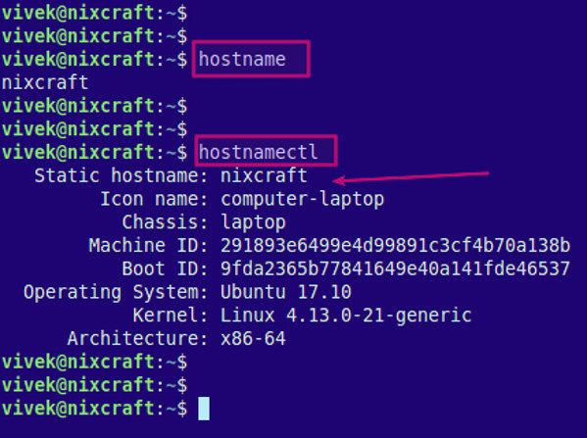
hostname command
If you want to know the name of your host/network simply type hostname. Adding a -I to the end will display the IP address of your network.
Hostnamectl
https://www.cyberciti.biz/faq/find-my-linux-machine-name/

Slide 74
host command
host command is a simple utility for performing DNS lookups. It is normally used to convert names to IP addresses and vice versa. When no arguments or options are given, host command displays a short summary of its command line arguments and options. The syntax is as follows:
host example.com
host -t TYPE example.com
host -t a example.com
https://www.cyberciti.biz/faq/unix-linux-dns-lookup-command/
Installation of host command if not found
root@user:~# apt-get update
root@user:~# apt-get install dnsutils –y
https://www.crybit.com/install-dig-nslookup-host-commands/

Slide 75
useradd, userdel command
Since Linux is a multi-user system, this means more than one person can interact with the same system at the same time. useradd is used to create a new user, while passwd is adding a password to that user’s account. To add a new person named John type, useradd John and then to add his password type, passwd 123456789.
To remove a user is very similar to adding a new user. To delete the users account type, userdel UserName

Slide 76
Tips and Tricks for Linux CLI
Try the TAB button to autofill what you are typing
For example, if you need to type Documents, begin to type a command (let’s go with cd Docu, then hit the TAB key) and the terminal will fill in the rest, showing you cd Documents
Ctrl+C and Ctrl+Z are used to stop any command that is currently working
Ctrl+C will stop and terminate the command, while Ctrl+Z will simply pause the command.
If you accidental freeze your terminal by using Ctrl+S, simply undo this with the unfreeze Ctrl+Q.
Ctrl+A moves you to the beginning of the line while Ctrl+E moves you to the end
You can run multiple commands in one single command by using the “;” to separate them. For example Command1; Command2; Command3. Or use && if you only want the next command to run when the first one is successful.

Slide 77
Useful Windows Commands

Slide 78
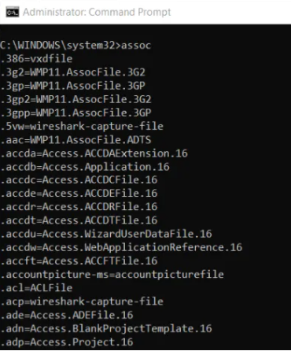
ASSOC: Fix File Associations
One of the most powerful tools in the CMD command library is the ASSOC command.
Your computer associates certain file extensions with certain programs. This is how your computer knows to open Adobe when you double click a PDF file, or Microsoft Word when you double click a DOC file.
You can view all the file associations your computer knows about by typing ASSOC in the command window. You’ll see the file extension and the program it’s associated with.
You can set the association by typing something like assoc .doc=Word.Document.8.

Slide 79
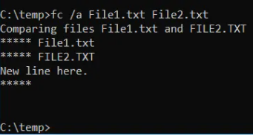
FC: File Compare
Sometimes when files are changed over time, it’s hard to remember what the differences were between versions. You may not know that a CMD command offers the ability to compare files and see all differences, but it’s true.
The FC command performs either an ascii or a binary file comparison and will list all of the differences that it finds.
Fc /a File1.txt File2.txt will compare two ascii files.
Fc /b Picture1.jpg Picture2.jpg will do a binary compare on two images.

Slide 80
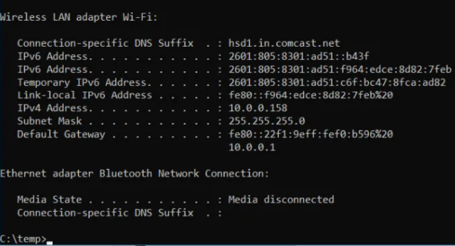
IPCONFIG: IP Configuration
Network troubleshooting is never simple, but one command that makes it much easier is IPCONFIG.
Using this command in the CMD command prompt returns detailed information about your current network adapter connection including:
Current IP Address
Subnet Mask
Default Gateway IP
Current domain
This information can help you troubleshoot router issues and other connection issues you could be having with your network adapter.

Slide 81
IPCONFIG: IP Configuration
Examples:
> ipconfig ... Show information
> ipconfig /all ... Show detailed information
> ipconfig /renew ... renew all adapters
> ipconfig /renew EL* ... renew any connection that has its name starting with EL
> ipconfig /release *Con* ... release all matching connections, eg. "Wired Ethernet Connection 1" or "Wired Ethernet Connection 2"
> ipconfig /allcompartments ... Show information about all
compartments
> ipconfig /allcompartments /all ... Show detailed information about all
compartments

Slide 82
IPCONFIG: IP Configuration
/? Display this help message
/all Display full configuration information.
/release Release the IPv4 address for the specified adapter.
/release6 Release the IPv6 address for the specified adapter.
/renew Renew the IPv4 address for the specified adapter.
/renew6 Renew the IPv6 address for the specified adapter.
/flushdns Purges the DNS Resolver cache.
/registerdns Refreshes all DHCP leases and re-registers DNS names
/displaydns Display the contents of the DNS Resolver Cache.
/showclassid Displays all the dhcp class IDs allowed for adapter.
/setclassid Modifies the dhcp class id.
/showclassid6 Displays all the IPv6 DHCP class IDs allowed for adapter.
/setclassid6 Modifies the IPv6 DHCP class id.

Slide 83
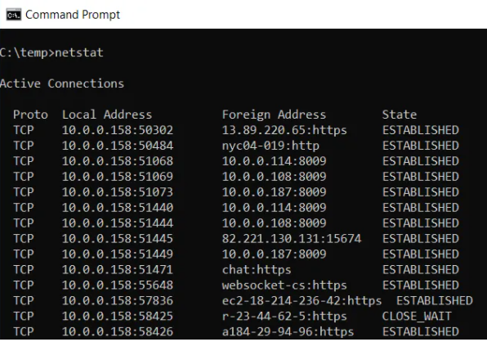
NETSTAT: Network Statistics
Concerned that you could have malware running on your computer that’s connecting to internet locations without you knowing about it?
If you run a NETSTAT command in the command prompt, you can get a list of all active TCP connections from your computer.

Slide 84
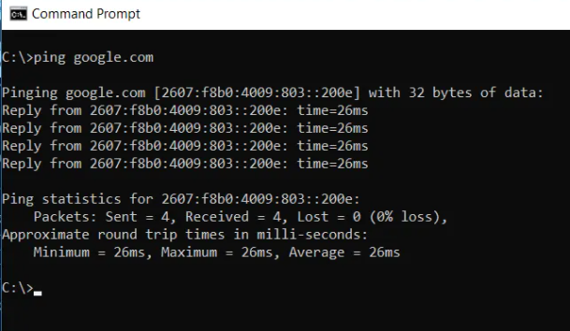
PING: Send Test Packets
An IT Analyst’s best friend is the PING command. Running this command sends test packets over the network to the target system.
You can use the PING command to test whether your computer can access another computer, a server, or even a website. It can help with revealing network disconnections. It also provides transit time for the packets in milliseconds, so it also reveals a bad network connection as well.

Slide 85
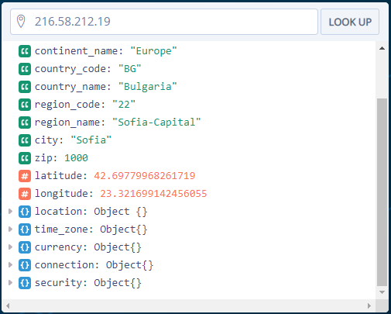
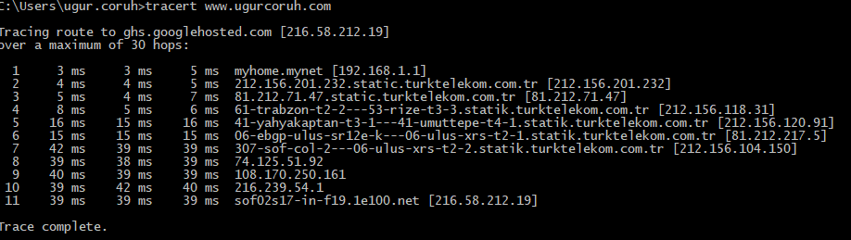
TRACERT: Trace Route
https://ipstack.com/
ipstack offers one of the leading IP to geolocation APIs and global IP database services worldwide.
TRACERT is a fascinating Windows Command to use. If you’re ever curious to see the path your internet traffic takes to get from your browser to a remote system like Google servers, you can use TRACERT to see it.
The command stands for “Trace Route”, which sends packets out to a remote destination (server or website), and provides you with all of the following information:
Number of hops (intermediate servers) before getting to the destination
Time it takes to get to each hop
The IP and sometimes the name of each hop
TRACERT can reveal how the routes of your internet requests change depending where you’re accessing the web. It also helps with troubleshooting a router or switch on a local network that may be problematic.

Slide 86
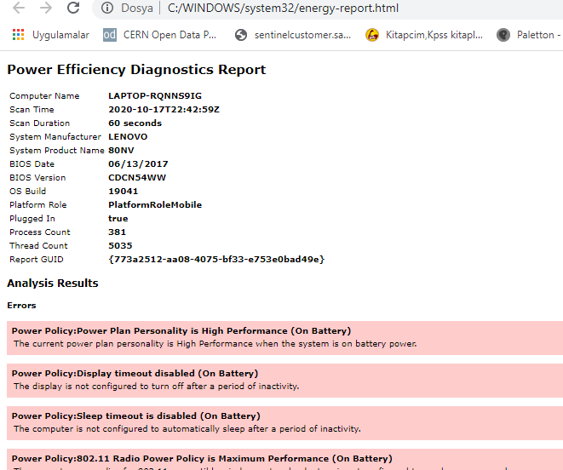
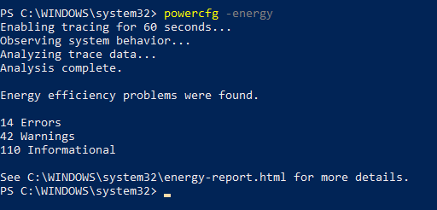
POWERCFG: Power Configuration
Are you frustrated with how quickly your laptop seems to run out of power? It could be that your power settings are configured as efficiently as possible. There’s a windows CMD command called POWERCFG (power configuration) that can help. Run the command prompt as an administrator and type
powercfg – energy to get a full power efficiency report.
The process can take up to about a minute, but when it’s done, you’ll see whether there are any warnings or errors that might help you improve the power efficiency of your system.

Slide 87
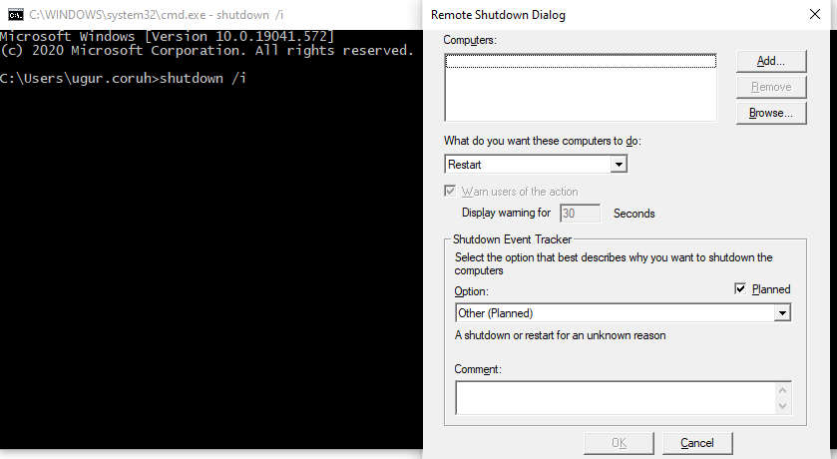
SHUTDOWN: Turn Off Computer
The SHUTDOWN command is a pretty versatile command that lets you shutdown the computer but control the behavior of that shutdown. It’s commonly used as a scheduled task or part of an IT batch job after patches have been applied to a computer system.
Typing shutdown /i from the command prompt will initiate a shutdown, but it’ll upon a GUI to give the user an option on whether to restart or do a full shutdown. If you don’t want to have any GUI pop up, you can just issue a shutdown /s command.
There is a long list of other parameters you can use to do a log off, hibernate, restart, and more. Just type shutdown without any arguments to see them all.

Slide 88
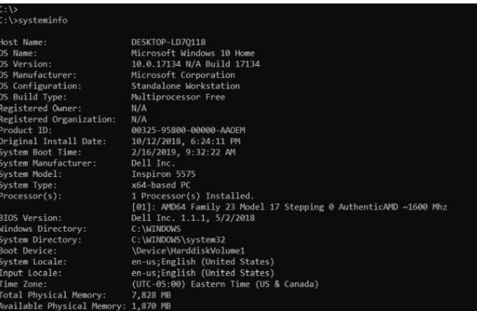
SYSTEMINFO: System Information
If you need to know what brand of network card you have, processor details, or the exact version of your Windows OS, the SYSTEMINFO command can help.
This command polls your system and pulls the most important information about your system. It lists the information in a clean format that’s easy to read.

Slide 89
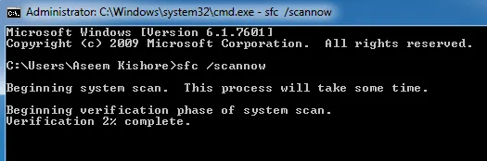
SFC: System File Checker
If you’re ever concerned that a virus or some other software might have corrupted your core system files, there’s a Windows command that can scan those files and ensure their integrity.
You need to launch CMD as administrator (right click and choose Run as Administrator). Typing SFC /SCANNOW will check the integrity of all protected system files. If a problem is found, the files will be repaired with backed-up system files.
The SFC command also lets you:
/VERIFYONLY: Check the integrity but don’t repair the files.
/SCANFILE: Scan the integrity of specific files and fix if corrupted.
/VERIFYFILE: Verify the integrity of specific files but don’t repair them.
/OFFBOOTDIR: Use this to do repairs on an offline boot directory.
/OFFWINDIR: Use this to do repairs on an offline Windows directory.
/OFFLOGFILE: Specify a path to save a log file with scan results.
The scan can take up to 10 or 15 minutes, so give it time.

Slide 90
NET USE: Map drives
If you want to map a new drive, you could always open File Explorer, right click on This PC, and go through the Map Network Drive wizard. However, using the NET USE command, you can do the same thing with one command string.
For example, if you have a share folder on a computer on your network called \\OTHER-COMPUTER\SHARE\, you can map this as your own Z: drive by typing the command:
NET USE Z: “\\OTHER-COMPUTER\SHARE” /persistent:yes
The persistent switch tells your computer that you want this drive remapped every time you log back into your computer.

Slide 91
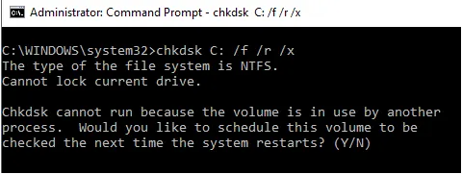
CHKDSK: Check Disk
While the SFC command only checks the integrity of core system files, you can use the CHKDSK command to scan an entire drive.
The command to check the C: drive and repair any problems, launch the command window as an administrator and type CHKDSK /f C:.
This command checks for things like:
File fragmentation
Disk errors
Bad sectors
The command can fix any disk errors (if possible). When the command is finished, you’ll see a status of the scan and what actions were taken.

Slide 92
SCHTASKS: Schedule Tasks
Windows comes with a wizard for creating scheduled tasks. For example, maybe you have a BAT file stored on C:\temp that you want to run every day at noon.
You’d have to click through the Scheduled Task wizard to configure this. Or you can type a single SCHTASKS command to set it up.
SCHTASKS /Create /SC HOURLY /MO 12 /TR Example /TN c:\temp\File1.bat
The scheduled switch accepts arguments like minute, hourly, daily, and monthly. Then you specify the frequency with the /MO command.
If you typed the command correctly, you’ll see the response, SUCCESS: The scheduled task “Example” has successfully been created.

Slide 93
ATTRIB: Change File Attributes
In Windows, you can change file attributes by right clicking on a file and finding the right property to change. However, instead of hunting around for the file attribute, you can use the ATTRIB command to set the file attributes.
For example, if you type: ATTRIB +R +H C:\temp\File1.bat, it’ll set File1.bat as a hidden, read-only file.
There is no response when it’s successful, so unless you see an error message, the command worked.

Slide 94
Other Windows CMD Commands
BITSADMIN: Initiate upload or download jobs over the network or internet and monitor the current state of those file transfers.
COLOR: Change the background color of the command prompt window.
COMP: Compare the contents of any two files to see the differences.
FIND/FINDSTR: Search for strings inside of any ASCII files.
PROMPT: Change the command prompt from C:\> to something else.
TITLE: Change the title of the command prompt window.
REGEDIT: Edit keys in the Windows registry (use with caution).
ROBOCOPY: A powerful file copy utility built right into Windows.

Slide 95
References
https://www.hostinger.com/tutorials/what-is-cli
https://www.hostinger.com/tutorials/linux-commands
https://tutorial.djangogirls.org/en/intro_to_command_line/
https://stackoverflow.com/questions/673523/how-do-i-measure-execution-time-of-a-command-on-the-windows-command-line
https://helpdeskgeek.com/help-desk/21-cmd-commands-all-windows-users-should-know/
http://derekmolloy.ie/hello-world-introductions-to-cmake/
https://cmake.org/cmake/help/v2.8.8/cmake.html
https://docs.microsoft.com/en-us/windows-server/administration/windows-commands/windows-commands

Slide 96
Remote Connection
How To Use SSH To Connect To A Remote Server In Linux Or Windows

Slide 97
Introduction
Accessing machines remotely became a necessity a long time ago and we can barely imagine how it would be if we couldn’t control computers from remote locations. There are many ways to establish a connection with a remote machine depending on the operating system you are running, but the two most used protocols are:
Secure Shell (SSH) for Linux-based machines
Remote Desktop Protocol (RDP) for Windows-based machines
The two protocols use the client and server applications to establish a remote connection. These tools allow you to gain access and remotely manage other computers, transfer files, and do virtually anything you can do while physically sitting in front of the machine.

Slide 98
Prerequisities
Before you can establish a secure remote desktop protocol with a remote machine, there are a few basic requirements to meet:
The remote computer must be turned on at all times and have a network connection.
The client and server applications need to be installed and enabled.
You need the IP address or the name of the remote machine you want to connect to.
You need to have the necessary permissions to access the remote computer.
Firewall settings need to allow the remote connection.

Slide 99
What is SSH?
Secure Shell, sometimes referred to as Secure Socket Shell, is a protocol which allows you to connect securely to a remote computer or a server by using a text-based interface.
When a secure SSH connection is established, a shell session will be started, and you will be able to manipulate the server by typing commands within the client on your local computer.
System and network administrators use this protocol the most, as well as anyone who needs to manage a computer remotely in a highly secure manner.

Slide 100
How Does SSH Work?
In order to establish an SSH connection, you need two components: a client and the corresponding server-side component. An SSH client is an application you install on the computer which you will use to connect to another computer or a server. The client uses the provided remote host information to initiate the connection and if the credentials are verified, establishes the encrypted connection.
On the server’s side, there is a component called an SSH daemon that is constantly listening to a specific TCP/IP port for possible client connection requests. Once a client initiates a connection, the SSH daemon will respond with the software and the protocol versions it supports and the two will exchange their identification data. If the provided credentials are correct, SSH creates a new session for the appropriate environment.
The default SSH protocol version for SSH server and SSH client communication is version 2

Slide 101
How to Enable an SSH Connection
Since creating an SSH connection requires both a client and a server component, you need to make sure they are installed on the local and the remote machine, respectively. An open source SSH tool—widely used for Linux distributions— is OpenSSH. Installing OpenSSH is relatively easy. It requires access to the terminal on the server and the computer that you use for connecting. Note that Ubuntu does not have SSH server installed by default.

Slide 102
How to Install an OpenSSH Client
Before you proceed with installing an SSH client, make sure it is not already installed. Many Linux distributions already have an SSH client. For Windows machines, you can install PuTTY or any other client of your choice to gain access to a server.
To check if the client is available on your Linux-based system, you will need to:
Load an SSH terminal. You can either search for “terminal” or press CTRL + ALT + T on your keyboard.
Type in ssh and press Enter in the terminal.
If the client is installed, you will receive a response that looks like this:

Slide 103
How to Install an OpenSSH Client (Linux)
This means that you are ready to remotely connect to a physical or virtual machine. Otherwise, you will have to install the OpenSSH client:
username@host:~$ ssh
usage: ssh [-1246AaCfGgKkMNnqsTtVvXxYy] [-b bind_address] [-c cipher_spec]
[-D [bind_address:]port] [-E log_file] [-e escape_char]
[-F configfile] [-I pkcs11] [-i identity_file]
[-J [user@]host[:port]] [-L address] [-l login_name] [-m mac_spec] [-O ctl_cmd] [-o option] [-p port] [-Q query_option] [-R address] [-S ctl_path] [-W host:port] [-w local_tun[:remote_tun]]
[user@]hostname [command]
username@host:~$

Slide 104
How to Install an OpenSSH Client (Linux)
Run the following command to install the OpenSSH client on your computer:
sudo apt-get install openssh-client
Type in your superuser password when asked.
Hit Enter to complete the installation.
You are now able to SSH into any machine with the server-side application on it, provided that you have the necessary privileges to gain access, as well as the hostname or IP address.

Slide 105
How to Install an OpenSSH Server (Linux)
In order to accept SSH connections, a machine needs to have the server-side part of the SSH software toolkit.
If you first want to check if OpenSSH server is available on the Ubuntu system of the remote computer that needs to accept SSH connections, you can try to connect to the local host:
Open the terminal on the server machine. You can either search for “terminal” or press CTRL + ALT + T on your keyboard.
Type in ssh localhost and hit enter.
For the systems without the SSH server installed the response will look similar to this:

Slide 106
How to Install an OpenSSH Server (Linux)
username@host:~$ ssh localhost
ssh: connect to host localhost port 22: Connection refused username@host:~$
If the above is the case, you will need to install the OpenSSH server. Leave the terminal open and:

Slide 107
How to Install an OpenSSH Server (Linux)
Run the following command to install the SSH server:
sudo apt-get install openssh-server ii.
Type in your superuser password when asked.
Enter and Y to allow the installation to continue after the disk space prompt.
The required support files will be installed

Slide 108
How to Install an OpenSSH Server (Linux)
you can check if the SSH server is running on the machine by typing this command:
sudo service ssh status
The response in the terminal should look similar to this if the SSH service is now running properly:
username@host:-$ sudo service ssh status
• ssh.service - OpenBSD Secure Shell server
Loaded: loaded (/lib/systemd/system/ssh.service; enabled; vendor preset: enab
Active: active (running) since Fr 2018-03-12 10:53:44 CET; 1min 22s ago Process: 1174 ExecReload=/bin/kill -HUP $MAINPID (code=exited, status=0/SUCCES
Main PID: 3165 (sshd)

Slide 109
How to Install an OpenSSH Server (Linux)
Another way to test if the OpenSSH server is installed properly and will accept connections is to try running the ssh localhost command again in your terminal prompt. The response will look similar to this screen when you run the command for the first time:
username@host:~$ ssh localhost
The authenticity of host 'localhost (127.0.0.1)' can't be established. ECDSA key fingerprint is SHA256:9jqmhko9Yo1EQAS1QeNy9xKceHFG5F8W6kp7EX9U3Rs. Are you sure you want to continue connecting (yes/no)? yes
Warning: Permanently added 'localhost' (ECDSA) to the list of known hosts.
username@host:~$
Enter yes or y to continue.
Congratulations! You have set up your server to accept SSH connection requests from a different computer using an SSH client.

Slide 110
How to Install an OpenSSH Server (Linux)
You can now edit the SSH daemon configuration file, for example, you can change the default port for SSH connections. In the terminal prompt, run this command:
sudo nano /etc/ssh/sshd_config
The configuration file will open in the editor of your choice. In this case, we used Nano.
If you need to install Nano, run this command:
sudo apt-get install nano
Please note that you need to restart SSH service every time you make any changes to the sshd_config file by running this command:
sudo service ssh restart

Slide 111
Installing SFTP/SSH Server on Windows using OpenSSH
Recently, Microsoft has released a port of OpenSSH for Windows. You can use the package to set up an SFTP/SSH server on Windows.
On Windows 10 version 1803 and newer
In Settings app, go to Apps > Apps & features > Manage optional features.
Locate “OpenSSH server” feature, expand it, and select Install.
Binaries are installed to %WINDIR%\System32\OpenSSH. Configuration file (sshd_config) and host keys are installed to %ProgramData%\ssh (only after the server is started for the first time).
You may still want to use the following manual installation, if you want to install a newer version of OpenSSH than the one built into Windows 10.
On earlier versions of Windows
Download the latest OpenSSH for Windows binaries (package OpenSSH-Win64.zip or OpenSSH-Win32.zip)
As the Administrator, extract the package to C:\Program Files\OpenSSH
As the Administrator, install sshd and ssh-agent services:
powershell.exe -ExecutionPolicy Bypass -File install-sshd.ps1

Slide 112
Configuring SSH server
Allow incoming connections to SSH server in Windows Firewall:
When installed as an optional feature, the firewall rule “OpenSSH SSH Server (sshd)” should have been created automatically. If not, proceed to create and enable the rule as follows.
Either run the following PowerShell command as the Administrator:
New-NetFirewallRule -Name sshd -DisplayName 'OpenSSH SSH Server' -Enabled True -Direction Inbound -Protocol TCP -Action Allow -LocalPort 22 -Program "C:\System32\OpenSSH\sshd.exe"
Replace C:\System32\OpenSSH\sshd.exe with the actual path to the sshd.exe (C:\Program Files\OpenSSH\ssh.exe, had you followed the manual installation instructions above).
or go to Control Panel > System and Security > Windows Firewall1 > Advanced Settings > Inbound Rules and add a new rule for port 22.
Start the service and/or configure automatic start:
Go to Control Panel > System and Security > Administrative Tools and open Services. Locate OpenSSH SSH Server service.
If you want the server to start automatically when your machine is started: Go to Action > Properties. In the Properties dialog, change Startup type to Automatic and confirm.
Start the OpenSSH SSH Server service by clicking the Start the service.
These instructions are partially based on the official deployment instructions.
https://github.com/PowerShell/Win32-OpenSSH/wiki/Install-Win32-OpenSSH

Slide 113
Setting up SSH public key authentication
Follow a generic guide for Setting up SSH public key authentication in *nix OpenSSH server, with the following difference:
https://winscp.net/eng/docs/guide_public_key
Create the .ssh folder (for the authorized_keys file) in your Windows account profile folder (typically in C:\Users\username\.ssh).2
For permissions to .ssh folder and authorized_keys file, what matters are Windows ACL permissions, not simple *nix permissions. Set the ACL so that only a respective Windows account have a write access to the folder and the file (what is the default access level, if you create the folder and the file, while logged in using the respective account).
Though, with the default Win32-OpenSSH configuration there is an exception for accounts with Administrator privileges. For these, the server uses a different location for the authorized keys file: %ALLUSERSPROFILE%\ssh\administrators_authorized_keys (i.e. typically C:\ProgramData\ssh\administrators_authorized_keys).

Slide 114
Connecting to the server
Finding Host Key
Before the first connection, find out fingerprint of the server’s host key by using ssh-keygen.exe for each file.
In Windows command-prompt, use:
for %f in (%ProgramData%\ssh\ssh_host_*_key) do @%WINDIR%\System32\OpenSSH\ssh-keygen.exe -l -f "%f"
Replace %WINDIR%\System32 with %ProgramFiles%, if appropriate.
In PowerShell, use:
Get-ChildItem $env:ProgramData\ssh\ssh_host_*_key | ForEach-Object { . $env:WINDIR\System32\OpenSSH\ssh-keygen.exe -l -f $_ }
Replace $env:WINDIR\System32 with $env:ProgramFiles, if appropriate.
You will get an output like this:
C:\Windows\System32\OpenSSH>for %f in (%ProgramData%\ssh\ssh_host_*_key) do @%WINDIR%\System32\OpenSSH\ssh-keygen.exe -l -f "%f"
1024 SHA256:K1kYcE7GHAqHLNPBaGVLOYBQif04VLOQN9kDbiLW/eE martin@example (DSA)
256 SHA256:7pFXY/Ad3itb6+fLlNwU3zc6X6o/ZmV3/mfyRnE46xg martin@example (ECDSA)
256 SHA256:KFi18tCRGsQmxMPioKvg0flaFI9aI/ebXfIDIOgIVGU martin@example (ED25519)
2048 SHA256:z6YYzqGiAb1FN55jOf/f4fqR1IJvpXlKxaZXRtP2mX8 martin@example (RSA)

Slide 115
Connecting to the server for SFTP
Connecting
Start WinSCP. Login dialog will appear. On the dialog:
Make sure New site node is selected.
On New site node, make sure the SFTP protocol is selected.
Enter your machine/server IP address (or a hostname) into the Host name box.
Enter your Windows account name to the User name box. It might have to be entered in the format user@domain, if running on a domain.
For a public key authentication:
Press the Advanced button to open Advanced site settings dialog and go to SSH > Authentication page.
In Private key file box select your private key file.
Submit Advanced site settings dialog with the OK button.
For a password authentication:
Enter your Windows account password to the Password box.
If you Windows account does not have a password, you cannot authenticate with the password authentication (i.e. with an empty password), you need to use the public key authentication.
Save your site settings using the Save button.
Login using Login button.
Verify the host key by comparing fingerprint with those collected before (see above).
If you cannot authenticate to the server, and you are using Windows 10 Developer mode, make sure that your OpenSSH server does not conflict with an internal SSH server used by the Developer mode. You may need to turn off the SSH Server Broker and SSH Server Proxy Windows services. Or run your OpenSSH server on a different port than 22.

Slide 116
How to Connect via SSH
Now that you have the OpenSSH client and server installed on every machine you need, you can establish a secure remote connection with your servers. To do so:
Open the SSH terminal on your machine and run the following command:
ssh your_username@host_ip_address
If the username on your local machine matches the one on the server you are trying to connect to, you can just type:
ssh host_ip_address
And hit Enter.
Type in your password and hit Enter. Note that you will not get any feedback on the screen while typing. If you are pasting your password, make sure it is stored safely and not in a text file.
When you are connecting to a server for the very first time, it will ask you if you want to continue connecting. Just type yes and hit Enter. This message appears only this time since the remote server is not identified on your local machine.
An ECDSA key fingerprint is now added and you are connected to the remote server.

Slide 117
How to Connect via SSH
If the computer you are trying to remotely connect to is on the same network, then it is best to use the private IP address instead of the public IP address. Otherwise, you will have to use the public IP address only.
Additionally, make sure that you know the correct TCP port OpenSSH is listening to for connection requests and that the port forwarding settings are correct.
The default port is 22 if nobody changed configuration in the sshd_config file.
You may also just append the port number after the host IP address.
Here is the example of a connection request using the OpenSSH client. We will specify the port number as well:
username@machine:~$ ssh phoenixnap@185.52.53.222 –p7654 phoenixnap@185.52.53.222’s password:
The authenticity of host '185.52.53.222 (185.52.53.222)' can't be established. ECDSA key fingerprint is SHA256:9lyrpzo5Yo1EQAS2QeHy9xKceHFH8F8W6kp7EX2O3Ps. Are you sure you want to continue connecting (yes/no)? yes
Warning: Permanently added ' 185.52.53.222' (ECDSA) to the list of known hosts.
username@host:~$

Slide 118
How to Connect via SSH
You are now able to manage and control a remote machine using your terminal. If you have trouble connecting to a remote server, make sure that:
The IP address of the remote machine is correct.
The port SSH daemon is listening to is not blocked by a firewall or forwarded incorrectly.
Your username and password are correct.
The SSH software is installed properly.

Slide 119
SSH Further Steps
Now that you are able to establish a connection to your server using SSH, we highly recommend a few further steps to improve SSH security. When you leave the setup with the default values, it is more likely to be hacked and your server can easily become a target of scripted attacks.
https://phoenixnap.com/kb/linux-ssh-security

Slide 120
SSH Further Steps
Some of the suggestions for hardening SSH by editing the sshd configuration file include:
Change the default TCP port where SSH daemon is listening. Change it from 22 to something much higher, for example 24596. Make sure you do not use a port number that is easy to guess, such as 222, 2222 or 22222.
Use SSH key pairs for authentication for passwordless SSH login. They are both safer and also allow logging in without the need to use your password (which is faster and more convenient).
Disable password-based logins on your server. If your password gets cracked, this will eliminate the possibility of using it to log into your servers. Before you disable the option to log in using passwords, it is important to make sure that authentication using key pairs is working properly.
Disable root access to your server and use a regular account with the su - command to switch to a root user.

Slide 121
SSH Further Steps
You can also use TCP wrappers to restrict access to certain IP addresses or hostnames. Configure which host can connect using TCP wrappers by editing the /etc/hosts.allow and etc/hosts.deny files.
Note that allowed hosts supersede the denied hosts. For example, to allow SSH access to a single host you will first deny all hosts by adding these two lines in the etc/hosts.deny:
sshd : ALL
ALL : ALL
Then, in the etc/hosts.allow add a line with the allowed hosts for the SSH service. That can be a single IP address, an IP range, or a hostname: sshd : 10.10.0.5, LOCAL.
Make sure to keep your log in information secure at all times and to apply security at multiple layers. Use different methods to limit SSH access to your servers, or use services that will block anyone who tries to use brute force to gain access to your servers. Fail2ban is one example of such service.

Slide 122
VNC Over SSH
For users who are used to working in a graphical desktop environment with Virtual Network Computing (VNC), it is possible to completely encrypt connections using SSH tunneling. In order to tunnel VNC connections over SSH, you will need to run this command in the terminal on your Linux or UNIX machine:
$ ssh -L 5901:localhost:5901 -N -f -l username hostname_or_IP

Slide 123
VNC Over SSH
$ ssh -L 5901:localhost:5901 -N -f -l username hostname_or_IP
Here is the breakdown of the command above:
ssh : this starts the SSH client program on your local machine and enables secure connection to the SSH server on a remote computer.
-L 5901:localhost:5901 : states that the local port for the client on the local machine is to be forwarded to the specified host and port of the remote machine. In this case, local port 5901 on the local client is being forwarded to the same port of the given remote server.
-N : instructs to only forward ports, and not to execute a remote command.
-f : sends SSH to background after the password is provided, just before the command is executed. Then, you can freely use the terminal to type commands on the local machine.
-l username : the username you insert here will be used for logging in to the remote server you specified.
hostname_or_IP : this is the remote system with a VNC server. An example of an IP address would be 172.16.0.5 and the example of a hostname would be myserver.somedomain.com.

Slide 124
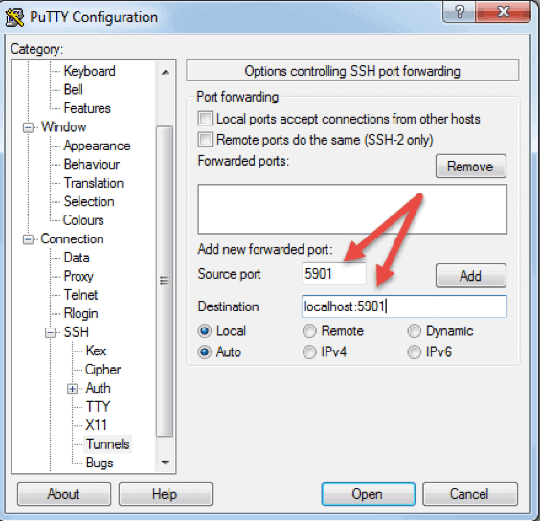
VNC Over SSH
https://www.tightvnc.com/
https://mobaxterm.mobatek.net/
https://www.putty.org/
You can also connect to a remote server via SSH tunnel from a Windows machine by using PuTTY. In the PuTTY configuration window:
Go to Connection -> SSH -> Tunnels
In the Source port field type in 5901
In the Destination field type in localhost:5901ssh putty configuration
Start the SSH session as you normally would.
Connect to your server with a VNC client of your choice.

Slide 125
Remote Connection Tools (Putty)
PuTTY is an SSH and telnet client for the Windows platform. PuTTY is open source software that is available with source code
Web Page
https://www.putty.org/

Slide 126

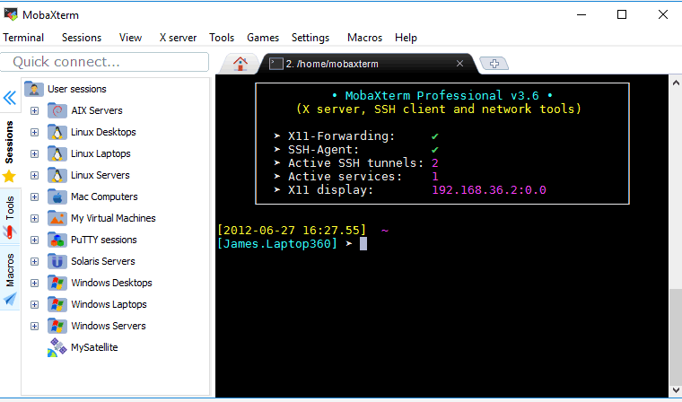
Remote Connection Tools (MobaXterm)
MobaXterm is your ultimate toolbox for remote computing. In a single Windows application, it provides loads of functions that are tailored for programmers, webmasters, IT administrators and pretty much all users who need to handle their remote jobs in a more simple fashion.
Web Page
https://mobaxterm.mobatek.net/

Slide 127
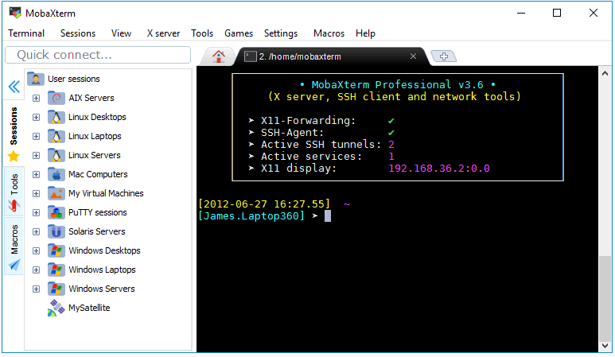
Remote Connection Tools (MobaXterm)
MobaXterm tabbed terminal
From this console window, you will be allowed to run the Unix commands you need: ls, cd, grep, awk, tail, cut, sed, wget, rsync, telnet, ssh, rlogin, rsh ... All the essential Unix tools are present. If you need a program that is not available in the basic MobaXterm file, you can download the free plugins.

Slide 128
Remote Connection Tools (MobaXterm)
Sessions management
MobaXterm allows you to launch remote sessions. You can choose to create SSH, Telnet, Rlogin, RDP, VNC, XDMCP, FTP, SFTP or Serial sessions. Every session you start is automatically saved and displayed in the left sidebar

Slide 129
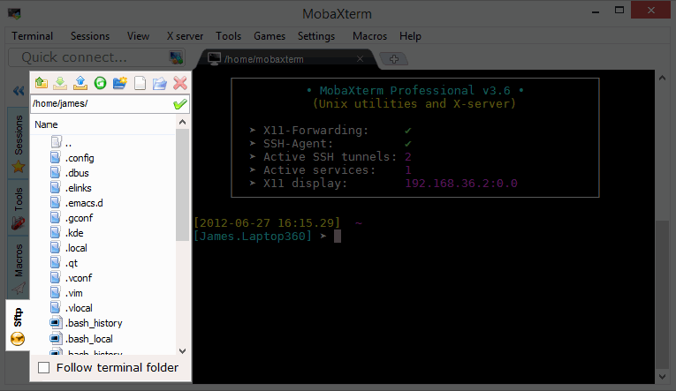
Remote Connection Tools (MobaXterm)
Graphical SFTP browser
When you log to a remote server using SSH, a graphical SFTP browser pops up on in the left sidebar. It allows you to drag and drop files directly from/to the remote server using a secure SFTP connection.

Slide 130

Remote Connection Tools (MobaXterm)
X11 server
When you run a SSH, TELNET or RLOGIN/RSH session you will be able to display your remote applications directly on your local Windows PC. In a SSH session, there is no need to set the "DISPLAY" variable as MobaXterm uses X11-forwarding in order to ease and secure your work.

Slide 131

Remote Connection Tools (MobaXterm)
Enhanced X extensions
The embedded X server based on X.org provides the latest features available in recent X server implementations: extensions such as OpenGL, Composite or Randr are included. Xdmcp protocol is also supported.

Slide 132
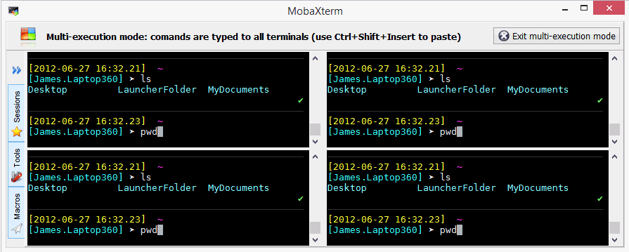
Remote Connection Tools (MobaXterm)
Multi-execution
Write once, execute everywhere: this tool allows you to execute the same commands on many different servers at the same time.

Slide 133
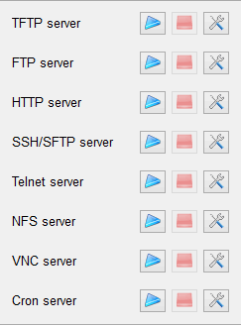
Remote Connection Tools (MobaXterm)
Embedded servers
MobaXterm allows you to start network daemons for remote access. No extra tool or runtime is needed in order to use these daemons.

Slide 134
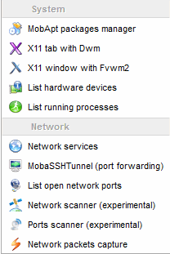
Remote Connection Tools (MobaXterm)
Embedded tools
MobaXterm brings some useful tools for sysadmins, developers, webmasters and all users who need to work efficiently with their computer.

Slide 135
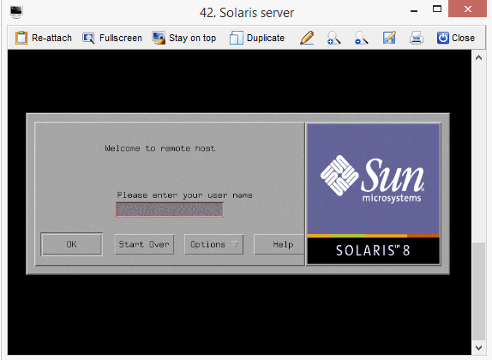
Remote Connection Tools (MobaXterm)
Remote Unix desktop (XDMCP)
Thanks to MobaXterm you can work on your remote Solaris desktop as if you were working locally on your Windows computer using the XDMCP protocol.

Slide 136
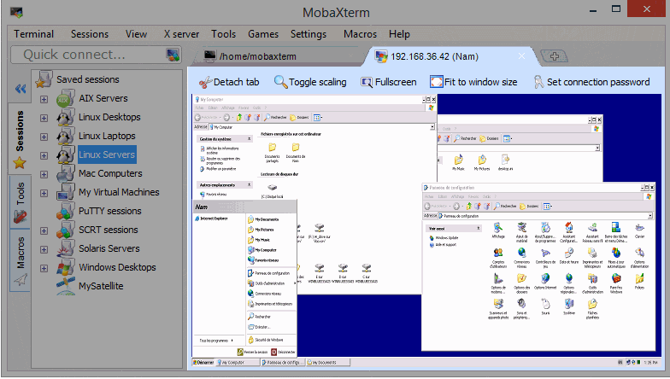
Remote Connection Tools (MobaXterm)
Remote Windows desktop (RDP)
Take control of your remote Windows computers/servers using the RDP protocol. Many RDP configuration settings are available in the session manager.

Slide 137

Remote Connection Tools (MobaXterm)
SSH gateway
In ssh, telnet, RDP, VNC sessions, you can select a "SSH-gateway" (a.k.a. "jump host") in order to tell MobaXterm to connect first to a SSH server before connecting to the end-server you want to reach in the end. This allow you to reach some servers behind a firewall and to secure your connection.

Slide 138

Remote Connection Tools (MobaXterm)
SSH tunnels (port forwarding)
The graphical SSH tunnels manager allows you to create your SSH tunnels using an intuitive graphical tool.

Slide 139

Remote Connection Tools (MobaXterm)
MobApt package manager
MobaXterm package manager (MobApt / apt-get) allows you to download and use much more Unix tools directly into MobaXterm terminal.

Slide 140

Remote Connection Tools (MobaXterm)
Text Editor
When you connect to a remote server using SSH, you will be able to edit remote files directly using the embedded text editor "MobaTextEditor" by just double-clicking on them!

Slide 141

Remote Connection Tools (MobaXterm)
Macros support
You can record macros in MobaXterm terminal: everything you type in the terminal will be recorded in order to replay it later on other servers.

Slide 142

Remote Connection Tools (MobaXterm)
Syntax highlighting in terminal
MobaXterm embedded terminal can highlight syntax or use coloration for keywords, even if you are connected to a remote server which does not support colors. This is useful especially when analyzing log files, editing code or trying to detect important keywords. You can even build your own syntax definitions easily.

Slide 143

Remote Connection Tools (MobaXterm)
Professional Customizer
MobaXterm Professional Edition gives you access to the "Customizer" software. This program allows you to generate customized copies of MobaXterm with your own logo and default settings.

Slide 144

Remote Connection Tools (MobaXterm)
MobaXterm live demo
https://mobaxterm.mobatek.net/demo.html

Slide 145
Remote Desktop using SSH Tunnel with MobaXterm
MobaXterm live demo

Slide 146
References
https://phoenixnap.com/kb/ssh-to-connect-to-remote-server-linux-or-windows
https://winscp.net/eng/docs/guide_windows_openssh_server
http://john-cd.com/cheatsheets/
https://mobaxterm.mobatek.net/features.html

Slide 147
Package Managers
https://en.wikipedia.org/wiki/List_of_software_package_management_systems

Slide 148
Chocolatey (Windows)
Requirements
Windows 7+ / Windows Server 2003+
PowerShell v2+
.NET Framework 4+ (the installation will attempt to install .NET 4.0 if you do not have it installed)
Install with cmd.exe
@"%SystemRoot%\System32\WindowsPowerShell\v1.0\powershell.exe" -NoProfile -InputFormat None -ExecutionPolicy Bypass -Command "iex ((New-Object System.Net.WebClient).DownloadString('https://chocolatey.org/install.ps1'))" && SET "PATH=%PATH%;%ALLUSERSPROFILE%\chocolatey\bin"

Slide 149
Chocolatey (Windows)
https://chocolatey.org/packages
Requirements
Windows 7+ / Windows Server 2003+
PowerShell v2+
.NET Framework 4+ (the installation will attempt to install .NET 4.0 if you do not have it installed)
Install with cmd.exe
@"%SystemRoot%\System32\WindowsPowerShell\v1.0\powershell.exe" -NoProfile -InputFormat None -ExecutionPolicy Bypass -Command "iex ((New-Object System.Net.WebClient).DownloadString('https://chocolatey.org/install.ps1'))" && SET "PATH=%PATH%;%ALLUSERSPROFILE%\chocolatey\bin"

Slide 150
Chocolatey (Windows)
Package List
https://chocolatey.org/packages
Sample Installations
>choco install googlechrome
>choco install jre8
>choco install notepadplusplus.install
choco install git

Slide 151
Ubuntu’s Advanced Packaging Tool (APT) (Linux)
Install a Package:
Installation of packages using the apt tool is quite simple.
For example, to install the nmap network scanner, type the following:
sudo apt install nmap
Remove a Package:
Removal of a package (or packages) is also straightforward.
To remove the package installed in the previous example, type the following:
sudo apt remove nmap
https://ubuntu.com/server/docs/package-management

Slide 152
Introduction to Source Code Management Systems
Git, Github, Gitlab, Bitbucket, Maven, SVN, TFS

Slide 153
Source code management
Source code management (SCM) is used to track modifications to a source code repository. SCM tracks a running history of changes to a code base and helps resolve conflicts when merging updates from multiple contributors. SCM is also synonymous with Version control.
As software projects grow in lines of code and contributor head count, the costs of communication overhead and management complexity also grow. SCM is a critical tool to alleviate the organizational strain of growing development costs.
https://www.atlassian.com/git/tutorials/source-code-management#:~:text=Source%20code%20management%20(SCM)%20is,also%20synonymous%20with%20Version%20control.

Slide 154
FEATURES OF SOURCE CODE MANAGEMENT
Authenticated access for commits
Revision history on files
Atomic commits of multiple files
Versioning/Tagging
https://www.linuxnix.com/what-is-source-code-management-or-version-control/

Slide 155
WHY DO WE NEED SOURCE CODE MANAGEMENT?
We can save the file with a different name if it’s our school project or one-time papers but for a well-equipped software development? Not a chance.
Big projects need a version control system to track the changes and avoid misunderstanding. A good SCM does the following:
Backup and Restore – Files can be saved at any moment and can be restored from the last saved.
Synchronization – Programmers can get the latest code and fetch the up-to-date codes from the repository.
Short-Term Undo – Working with a file and messed it up. We can do a short-term undo to the last known version.
Long-Term Undo – It helps when we have to make a release version rollback. Something like going to the last version which was created a year
Track Changes – We can track the changes as when anyone is making any change, he can leave a commit message as for why the change was done.
Ownership – With every commit made to the master branch, it will ask the owner permission to merge it.
Branching and Merging – You can create a branch of your source code and create the changes. Once the changes are approved, you can merge it with the master branch.
https://www.linuxnix.com/what-is-source-code-management-or-version-control/

Slide 156


TYPES OF VERSION CONTROL SYSTEMS (CENTRALIZED VERSION CONTROL)
The main concept of Centralized Version Control is that it works in a client and server relationship. The repository is located in one place and allows access to multiple clients.
It’s very similar to FTP where you have FTP clients which connect to FTP server. Here all the user changes and commits have to pass through the central server. For Ex: Subversion.
https://www.linuxnix.com/what-is-source-code-management-or-version-control/

Slide 157
TYPES OF VERSION CONTROL SYSTEMS (CENTRALIZED VERSION CONTROL)
The benefits of centralized version control are:
It’s easy to understand.
There are more GUI and IDE clients.
You have more control over the users and access.
We do have drawbacks also:
It is dependent on the access to the server.
It can be slower because every command from the client has to pass the server.
Branching and merging strategies are difficult to use.
https://www.linuxnix.com/what-is-source-code-management-or-version-control/

Slide 158


TYPES OF VERSION CONTROL SYSTEMS (DISTRIBUTED VERSION CONTROL)
These systems are newer to use. In Distributed Version Control, each user has their own copy of the entire repository as well as the files and history. For Ex: Git and Mercurial
https://www.linuxnix.com/what-is-source-code-management-or-version-control/

Slide 159
TYPES OF VERSION CONTROL SYSTEMS (DISTRIBUTED VERSION CONTROL)
The benefits of distributed version control are:
More powerful and easy change tracking.
No need of a centralized server. Most of the functionalities work in offline mode also apart from sharing the repositories.
Branching and Merging strategies are more easy and reliable.
It’s faster than the other one.
Though we have drawbacks:
It is harder to understand.
It is easier to make mistakes until you are familiar with the model.
https://www.linuxnix.com/what-is-source-code-management-or-version-control/

Slide 160
SOURCE CODE MANAGEMENT / VERSION CONTROL TOOLS
GitHub
GitLab
BitBucket
SourceForge
Beanstalk
Apache Allura
AWS CodeCommit
Launchpad
Phabricator
GitBucket
https://www.linuxnix.com/what-is-source-code-management-or-version-control/

Slide 161

Source code management

Slide 162

Source code management

Slide 163


Git
Distrubuted Source Code Version Control System

Slide 164

A basic overview of how Git works
https://www.edureka.co/blog/how-to-use-github/

Slide 165
A basic overview of how Git works
Create a “repository” (project) with a git hosting tool (like Bitbucket)
Copy (or clone) the repository to your local machine
Add a file to your local repo and “commit” (save) the changes
“Push” your changes to your master branch
Make a change to your file with a git hosting tool and commit
“Pull” the changes to your local machine
Create a “branch” (version), make a change, commit the change
Open a “pull request”.
“Merge” your branch to the master branch
https://www.edureka.co/blog/git-tutorial/

Slide 166
Some of the basic operations in Git are
Initialize
Add
Commit
Pull
Push
https://www.edureka.co/blog/git-tutorial/

Slide 167
Some advanced Git operations are
Branching
Merging
Rebasing
https://www.edureka.co/blog/git-tutorial/

Slide 168

A brief idea about how these operations work with the Git repositories
https://www.edureka.co/blog/git-tutorial/

Slide 169

A brief idea about how these operations work with the Git repositories
https://www.edureka.co/blog/git-tutorial/

Slide 170

Installation of Git
Check Installation Already Completed
> git --version

Slide 171
Installation of Git
Follow to steps in the following web pages
https://www.atlassian.com/git/tutorials/install-git#windows
https://www.edureka.co/blog/git-tutorial/

Slide 172
Installation of Git
setup
Download git for OSX
Download git for Windows
Download git for Linux
Download and Install Git from https://git-scm.com/downloads
https://www.edureka.co/blog/git-tutorial/

Slide 173






Installation of Git
https://www.edureka.co/blog/install-git/

Slide 174
Installation of Git Extension
You can install Git GUI from https://git-scm.com/downloads/guis
I prefer to use git extension https://gitextensions.github.io/ and https://tortoisegit.org/
These extensions provide GUI for git operations to make process easier.
https://www.edureka.co/blog/git-tutorial/

Slide 175

Configuration of Git Extension

Slide 176

Opening the Git Extension

Slide 177

Opening the Git Extension

Slide 178


Git Installation Completed
https://www.edureka.co/blog/install-git/

Slide 179

Installation of gig (git ignore creator)

Slide 180
Installation of gig (git ignore creator)
Requirements
Python >= 3.6
Internet connection
https://github.com/sloria/gig

Slide 181

Installation of gig (git ignore creator)
> gig list
> gig list –global
> gig C Java VisualStudio > .gitignore
Port of gitignore.io
https://www.toptal.com/developers/gitignore
https://github.com/github/gitignore
https://dev.to/shihanng/gig-a-gitignore-generator-opc

Slide 182


Configuration of Git
configuring Git with your username and email. In order to do that, type the following commands in your Git Bash:
git config - - global user.name "<your name>"
git config - - global user.email "<your email>"
It is important to configure your Git because any commits that you make are associated with your configuration details.
https://www.edureka.co/blog/install-git/

Slide 183

Configuration of Git
It is important to configure your Git because any commits that you make are associated with your configuration details.
If you want to view all your configuration details, use the command below:
git config - - list
https://www.edureka.co/blog/install-git/

Slide 184

With Gitignore

Slide 185

Without Gitignore

Slide 186

Github Create Repo
https://www.edureka.co/blog/how-to-use-github/

Slide 187
Initilization of Repo

Slide 188

git init
In order to do that, we use the command git init.
git init creates an empty Git repository or re-initializes an existing one. It basically creates a .git directory with sub directories and template files. Running a git init in an existing repository will not overwrite things that are already there. It rather picks up the newly added templates.

Slide 189

git status
The git status command lists all the modified files which are ready to be added to the local repository.

Slide 190
Adding Files to Index

Slide 191
git add
This command updates the index using the current content found in the working tree and then prepares the content in the staging area for the next commit.
git add <directory>
git add <file>
created two more files edureka3.txt and edureka4.txt. Let us add the files using the command git add -A. This command will add all the files to the index which are in the directory but not updated in the index yet.

Slide 192

git add

Slide 193
Commit Changes

Slide 194

git commit
It refers to recording snapshots of the repository at a given time. Committed snapshots will never change unless done explicitly. Let me explain how commit works with the diagram below
Here, C1 is the initial commit, i.e. the snapshot of the first change from which another snapshot is created with changes named C2. Note that the master points to the latest commit.
Now, when I commit again, another snapshot C3 is created and now the master points to C3 instead of C2.

Slide 195

git commit
Commands
git commit -m “<message>”

Slide 196

git commit
Now, if you want to commit a snapshot of all the changes in the working directory at once, you can use the command below:
git commit –a

Slide 197
git commit
Now, if you want to commit a snapshot of all the changes in the working directory at once, you can use the command below:
git commit –a
I have created two more text files in my working directory viz. edureka5.txt and edureka6.txt but they are not added to the index yet.

Slide 198
git commit
I am adding edureka5.txt using the command:
git add edureka5.txt
I have added edureka5.txt to the index explicitly but not edureka6.txt and made changes in the previous files. I want to commit all changes in the directory at once.

Slide 199
git commit
This command will commit a snapshot of all changes in the working directory but only includes modifications to tracked files i.e. the files that have been added with git add at some point in their history. Hence, edureka6.txt was not committed because it was not added to the index yet. But changes in all previous files present in the repository were committed, i.e. edureka1.txt, edureka2.txt, edureka3.txt, edureka4.txt and edureka5.txt. Now I have made my desired commits in my local repository.

Slide 200
Update local repo before sending

Slide 201
git pull
Note that before you affect changes to the central repository you should always pull changes from the central repository to your local repository to get updated with the work of all the collaborators that have been contributing in the central repository. For that we will use the pull command.

Slide 202

git pull
But first, you need to set your central repository as origin using the command:
git remote add origin <link of your central repository>
Now that my origin is set,

Slide 203

git pull
let us extract files from the origin using pull. For that use the command
git pull origin master
This command will copy all the files from the master branch of remote repository to your local repository.
Since my local repository was already updated with files from master branch, hence the message is Already up-to-date. Refer to the screen shot above

Slide 204
git pull
One can also try pulling files from a different branch using the following command:
git pull origin <branch-name>
Your local Git repository is now updated with all the recent changes. It is time you make changes in the central repository by using the push command.

Slide 205
Send Changes to Remote Repo

Slide 206
git push
This command transfers commits from your local repository to your remote repository. It is the opposite of pull operation.
Pulling imports commits to local repositories whereas pushing exports commits to the remote repositories .

Slide 207
git push
The use of git push is to publish your local changes to a central repository. After you’ve accumulated several local commits and are ready to share them with the rest of the team, you can then push them to the central repository by using the following command:
git push <remote>
This remote refers to the remote repository which had been set before using the pull command.
This pushes the changes from the local repository to the remote repository along with all the necessary commits and internal objects. This creates a local branch in the destination repository.

Slide 208

git push
The below files are the files which we have already committed previously in the commit section and they are all “push-ready“.
I will use the command git push origin master to reflect these files in the master branch of my central repository.

Slide 209

git push

Slide 210

git push
To prevent overwriting, Git does not allow push when it results in a non-fast forward merge in the destination repository.

Slide 211
git push
To prevent overwriting, Git does not allow push when it results in a non-fast forward merge in the destination repository.
A non-fast forward merge means an upstream merge i.e. merging with ancestor or parent branches from a child branch.
To enable such merge, use the command below:
git push <remote> –force
The above command forces the push operation even if it results in a non-fast forward merge.

Slide 212
Branching

Slide 213
git branch
Branches in Git are nothing but pointers to a specific commit. Git generally prefers to keep its branches as lightweight as possible.
There are basically two types of branches viz.
local branches
remote tracking branches.
A local branch is just another path of your working tree. On the other hand, remote tracking branches have special purposes. Some of them are:
They link your work from the local repository to the work on central repository.
They automatically detect which remote branches to get changes from, when you use git pull.

Slide 214
git branch – learn current branch
You can check what your current branch is by using the command:
git branch
The one mantra that you should always be chanting while branching is “branch early, and branch often”

Slide 215

git branch – create branch
To create a new branch we use the following command:
git branch <branch-name>
The diagram below shows the workflow when a new branch is created. When we create a new branch it originates from the master branch itself.
Since there is no storage/memory overhead with making many branches, it is easier to logically divide up your work rather than have big chunky branches.

Slide 216

git branch – create branch
Now, let us see how to commit using branches.
Branching includes the work of a particular commit along with all parent commits. As you can see in the diagram above, the newBranch has detached itself from the master and hence will create a different path.

Slide 217
Double-Check
https://rogerdudler.github.io/git-guide/index.html
https://github.com/rogerdudler/git-guide

Slide 218
Double-Check
https://rogerdudler.github.io/git-guide/index.html

Slide 219
Setup
Download git for OSX
Download git for Windows
Download git for Linux

Slide 220
create a new repository
create a new directory, open it and perform a
git init
to create a new git repository.

Slide 221
checkout a repository
create a working copy of a local repository by running the command
git clone /path/to/repository
when using a remote server, your command will be
git clone username@host:/path/to/repository

Slide 222

workflow
your local repository consists of three "trees" maintained by git. the first one is your Working Directory which holds the actual files. the second one is the Index which acts as a staging area and finally the HEAD which points to the last commit you've made.

Slide 223
add & commit
You can propose changes (add it to the Index) using
git add <filename>
git add *
This is the first step in the basic git workflow. To actually commit these changes use
git commit -m "Commit message"
Now the file is committed to the HEAD, but not in your remote repository yet.

Slide 224
pushing changes
Your changes are now in the HEAD of your local working copy. To send those changes to your remote repository, execute
git push origin master
Change master to whatever branch you want to push your changes to.
If you have not cloned an existing repository and want to connect your repository to a remote server, you need to add it with
git remote add origin <server>
Now you are able to push your changes to the selected remote server

Slide 225

branching
Branches are used to develop features isolated from each other. The master branch is the "default" branch when you create a repository. Use other branches for development and merge them back to the master branch upon completion.

Slide 226
branching
create a new branch named "feature_x" and switch to it using
git checkout -b feature_x
switch back to master
git checkout master
and delete the branch again
git branch -d feature_x
a branch is not available to others unless you push the branch to your remote repository
git push origin <branch>

Slide 227
update & merge
to update your local repository to the newest commit, execute
git pull
in your working directory to fetch and merge remote changes.
to merge another branch into your active branch (e.g. master), use
git merge <branch>
in both cases git tries to auto-merge changes. Unfortunately, this is not always possible and results in conflicts. You are responsible to merge those conflicts manually by editing the files shown by git. After changing, you need to mark them as merged with
git add <filename>
before merging changes, you can also preview them by using
git diff <source_branch> <target_branch>

Slide 228
tagging
it's recommended to create tags for software releases. this is a known concept, which also exists in SVN. You can create a new tag named 1.0.0 by executing
git tag 1.0.0 1b2e1d63ff
the 1b2e1d63ff stands for the first 10 characters of the commit id you want to reference with your tag. You can get the commit id by looking at the...

Slide 229
log
in its simplest form, you can study repository history using.. git log
You can add a lot of parameters to make the log look like what you want. To see only the commits of a certain author:
git log --author=bob
To see a very compressed log where each commit is one line:
git log --pretty=oneline
Or maybe you want to see an ASCII art tree of all the branches, decorated with the names of tags and branches:
git log --graph --oneline --decorate --all
See only which files have changed:
git log --name-status
These are just a few of the possible parameters you can use. For more, see git log --help

Slide 230
replace local changes
In case you did something wrong, which for sure never happens ;), you can replace local changes using the command
git checkout -- <filename>
this replaces the changes in your working tree with the last content in HEAD. Changes already added to the index, as well as new files, will be kept.
If you instead want to drop all your local changes and commits, fetch the latest history from the server and point your local master branch at it like this
git fetch origin
git reset --hard origin/master

Slide 231
useful hints
built-in git GUI
gitk
use colorful git output
git config color.ui true
show log on just one line per commit
git config format.pretty oneline
use interactive adding
git add -i

Slide 232
Advanced Tips
https://dev.to/lydiahallie/cs-visualized-useful-git-commands-37p1#merge
https://dev.to/chrissiemhrk/git-commit-message-5e21

Slide 233
Gource
https://gource.io/

Slide 234

Gource

Slide 235
Installation on Other OS (Pre-required Dev. Tools)
If you plan to use your computer to develop software, or simply install software from sources, you will need some basic tools like:
gcc
c++
make
others
These tools are installed in different ways, depending your Linux distribution, here I will cover Fedora, Debian and derivatives (like Ubuntu or Mint) and Arch Linux.
Fedora
sudo yum update
sudo yum groupinstall "Development Tools" "Legacy Software Development"
Debian / Ubuntu / Debian derivatives
sudo apt-get update
sudo apt-get install build-essential
Arch Linux
sudo pacman -Sy base-devel
https://www.garron.me/en/go2linux/gnu-gcc-development-tools-linux-fedora-arch-debian.html
https://www.edureka.co/blog/install-git/

Slide 236
A basic overview of how Git works
https://www.edureka.co/blog/how-to-use-github/

Slide 237

Source code management

Slide 238

Source code management
https://www.researchgate.net/publication/262450962_Rugby_An_Agile_Process_Model_Based_on_Continuous_Delivery

Slide 239

Source code management

Slide 240

Source code management

Slide 241
DevOps

Slide 242
DevOps principles
Automation:
Automate everything, such as workflows, testing new code, and how your infrastructure is provisioned to cut down on waste and overwork.
Iteration:
Write small chunks of code during a time-box sprint to support releases and sub-releases that increases the speed and frequency of deployments.
Continuous improvement:
Continuously test, learn from failures, and act on feedback in order to optimize performance, cost, and time to deployment.
Collaboration:
Unite teams, foster communication and breakdown silos between development, IT operations, and quality assuranc
https://www.lucidchart.com/blog/devops-process-flow

Slide 243

DevOps principles
https://www.lucidchart.com/blog/devops-process-flow

Slide 244

DevOps principles
https://www.lucidchart.com/blog/devops-process-flow

Slide 245

DevOps Flows and Tools
https://www.lucidchart.com/blog/devops-process-flow

Slide 246

DevOps Flows and Tools
https://devops.com/31-reference-architectures-devops-continuous-delivery/

Slide 247

DevOps Flows and Tools
https://medium.com/swlh/how-to-become-an-devops-engineer-in-2020-80b8740d5a52

Slide 248

DevOps Flows and Tools
https://harness.io/2018/01/devops-tools-lifecycle-mesh-2018/

Slide 249

DevOps Flows and Tools
https://blog.xebialabs.com/2016/06/14/periodic-table-devops-tools-v-2/

